Slide 1

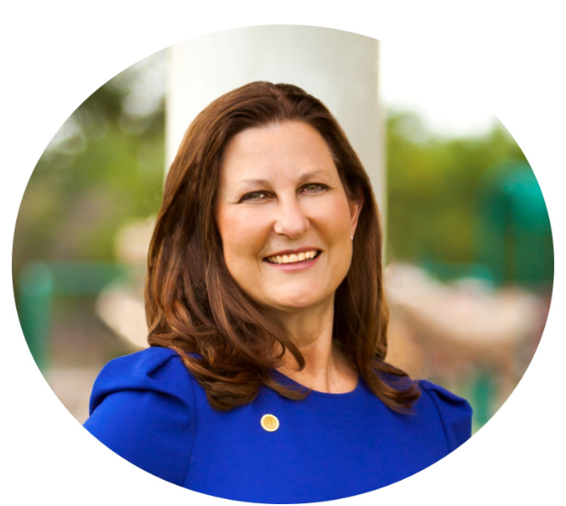
DISTRICT 13
COUNCIL MEMBER GAY DONNELL WILLIS
PUBLIC MEETING
RAMROCK PRESTON CENTER
April 10th, 2024

Slide 2
Introductions
Andrea Gilles, Interim Director, Planning & Urban Design
Larry Hall, City Plan Commissioner, District 13
Michael Williams, Council Liaison & Policy Advisor
Farrah Ali, Policy Analyst
Christopher Murray, Administrative Affairs
Robert Dozier, RAMROCK Real Estate
Gus Khankarli, Director of Transportation
David Nevarez, Engineering Program Administrator

Slide 3
Preferred vision for preston center
What is an Area Plan?
In 2017, the City Council of Dallas adopted the Northwest Highway and Preston Road Area Plan as a guide for future development, following collaborative efforts between local organizations, business owners, and area residents.

Slide 4
Preferred vision for preston center
What the Plan says:
Bold vision to transform this area into a vibrant mixed-use community center, where people can live, work, shop and be entertained
Preferred Vision encourages the development of multi-story buildings that feature retail space on the ground floor and residential and/or office uses on the upper floors, particularly on the sites that surround the parking garage
Preston Center has very little green space, and the streetscape and lighting is not consistent. In contrast, the portion of Preston Center located in University Park (east of Preston Road) is under common ownership and has achieved a much more upscale and inviting environment.

Slide 5
Preferred vision for preston center
What the Plan says:
Office space would have the greatest negative impact on traffic congestion; residential development would have less impact on traffic
Multi-family housing is critical for the creation of the type of mixed-use environment in the Preferred Vision
Potential for the creation of public-private partnerships to build/maintain a park and an underground parking garage
If public/private financing for the ideal solution cannot be identified within 24 months of the date of this report, an alternative plan to expand and upgrade the current garage should be pursued

Slide 6
Preferred vision for preston center
What the Plan says:
The City of Dallas should support more density, building height, Floor to Area Ratios and other land use concessions through the zoning process to encourage property owners to develop residential projects where commercial office could be built now by right, without compromising proximity slope protections for surrounding neighborhoods and while traffic solutions for the area are being actively pursued.

Slide 7
Traffic Study Update
Traffic data collection resumed after pre-COVID traffic levels returned
NTTA Dallas North Tollway Corridor Study (Downtown Dallas to Grayson County)
  April 2024 - Intergovernmental Agency Meeting
TXDOT Northwest Highway Corridor Study (Inwood to Hillcrest)
Awaiting traffic data from NTXCOG
  Early Fall – Public Meeting
Douglas Avenue (NW Hwy to Colgate)
  Design contract to be awarded by Council vote April 24

Slide 8
Traffic Study Update
TXDOT Northwest Highway to Walnut Hill Corridor Study
Roadway improvements
  Traffic signal upgrades
  Signage
  Pavement markings
  Pedestrian improvements
  Sidewalks

Slide 9
Legal Zoning notification process
November 23, 2022 - Zoning application submitted
Dallas Morning News advertisement
Rezoning signs posted around perimeter/interior business window
June 9, 2023 - Zoning Review Team letter
  Comments on proposed standards
January 26, 2024 Notification letters sent
March 7, 2024 – hearing scheduled, but placed under advisement until March 21, 2024
  Minor typo – required second mailing of postcards

Slide 10
Legal Zoning notification process
Responses
  63 property owners notified
    27 replies in favor/no opposed
  500 ft radius
March 21, 2024 – placed under advisement until
May 2, 2024

Slide 11
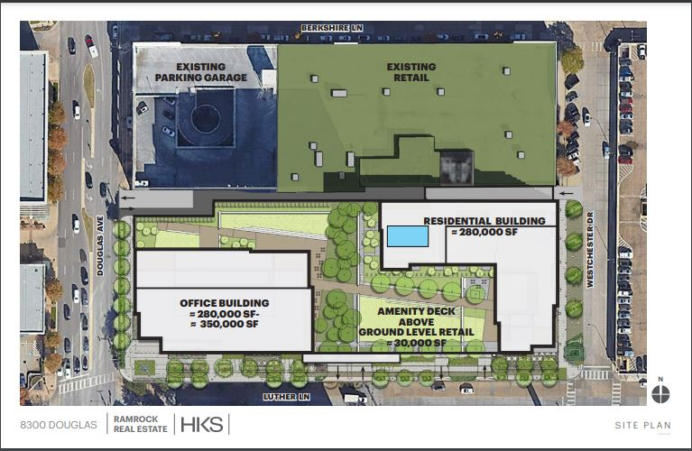
Ramrock Preston Center Design

Slide 12
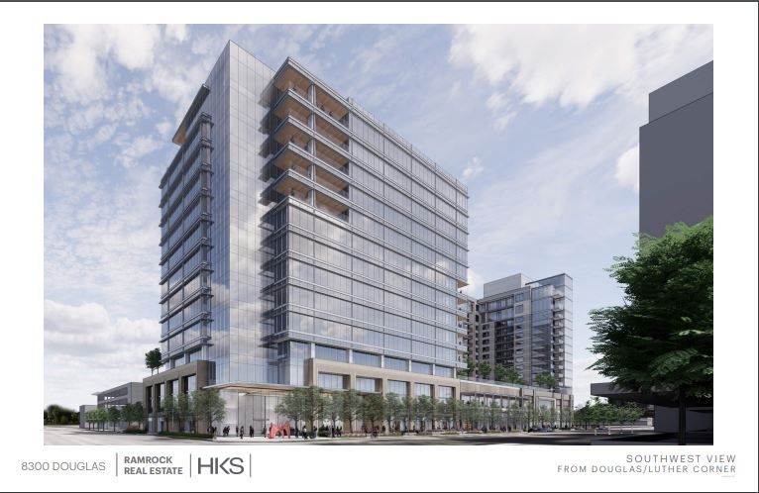
Ramrock Preston Center Design

Slide 13
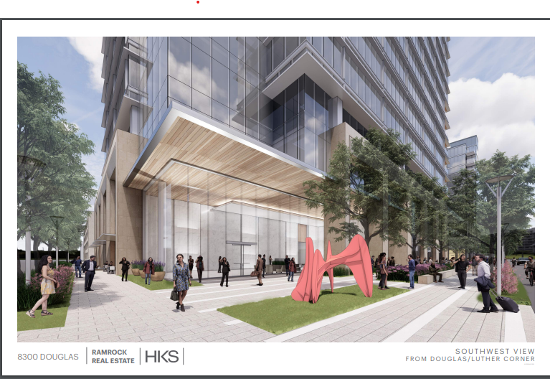
Ramrock Preston Center Design

Slide 14
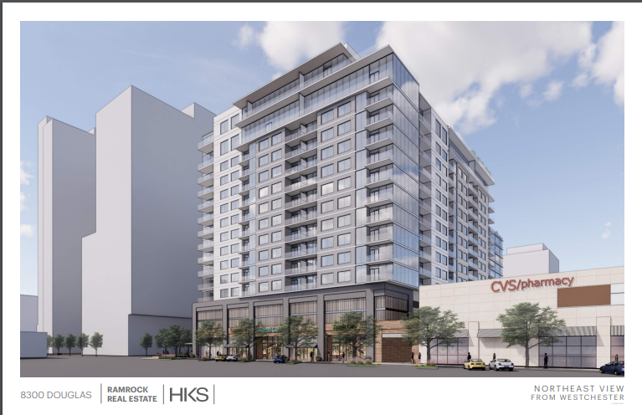
Ramrock Preston Center Design

Slide 15
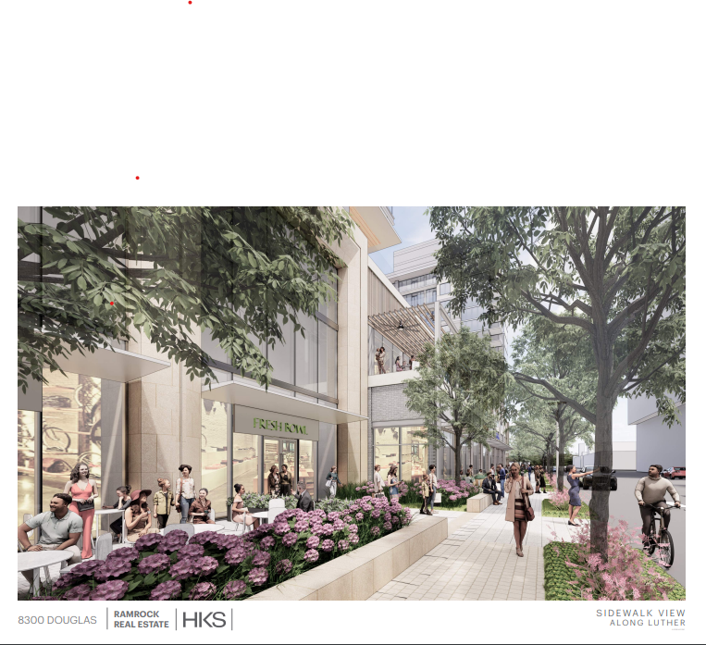
Ramrock Preston Center Design

Slide 16
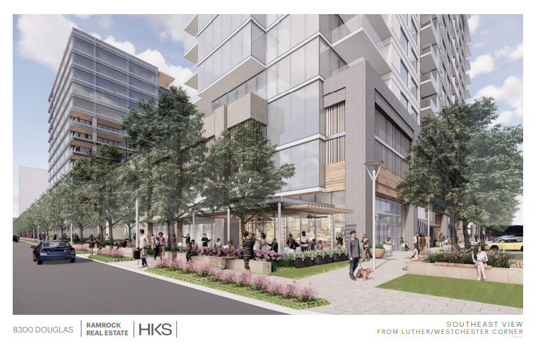
Ramrock Preston Center Design

Slide 17
Zoning and Public engagement process
Public Hearing at City Plan Commission
  Z 223-141 delayed to Thursday, May 2nd
Public Hearing at City Council Meeting

Slide 18
Questions and Communication
Questions will be collected, answered, and posted on the District 13 website
Send any additional questions or comments to gay.willis@dallas.gov or district13@dallas.gov

Slide 19
Appendix

Slide 20
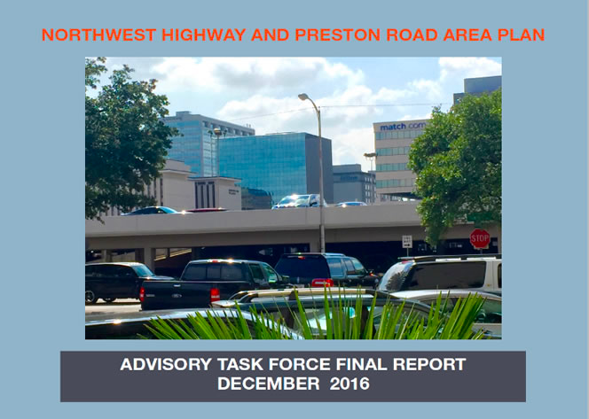
Preferred vision for preston center
VISION
The Northwest Highway and Preston Road Area Plan focuses on revitalizing Preston Center into a vibrant mixed-use hub while safeguarding the adjacent neighborhoods. It addresses critical issues like traffic congestion, parking inadequacies, and the need for improved pedestrian and bicycle access. Key strategies include redeveloping the outdated parking structure into an underground garage topped with a park, enhancing green spaces, and fostering a pedestrian-friendly environment.

Slide 21
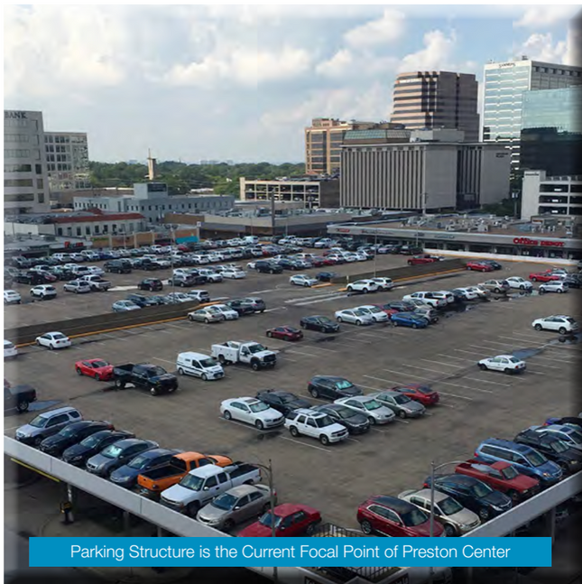
Preferred vision for preston center
The most critical element in the Preferred Vision for Preston Center is the redevelopment of the existing City-owned parking structure. It is totally unrealistic to expect 21st century mixed-use development to happen when the focal point of the entire neighborhood is an obsolete, 60-year old parking deck.

Slide 22
Preferred vision for preston center
The ideal plan would be to build a new underground parking garage with increased capacity (potentially doubling the 800-space capacity of the current garage) and a new public park as a centerpiece for the neighborhood. This would permit the creation of additional street level parking and a very pedestrian friendly environment. In order to take full advantage of the opportunity to create a vibrant neighborhood around the park

Slide 23
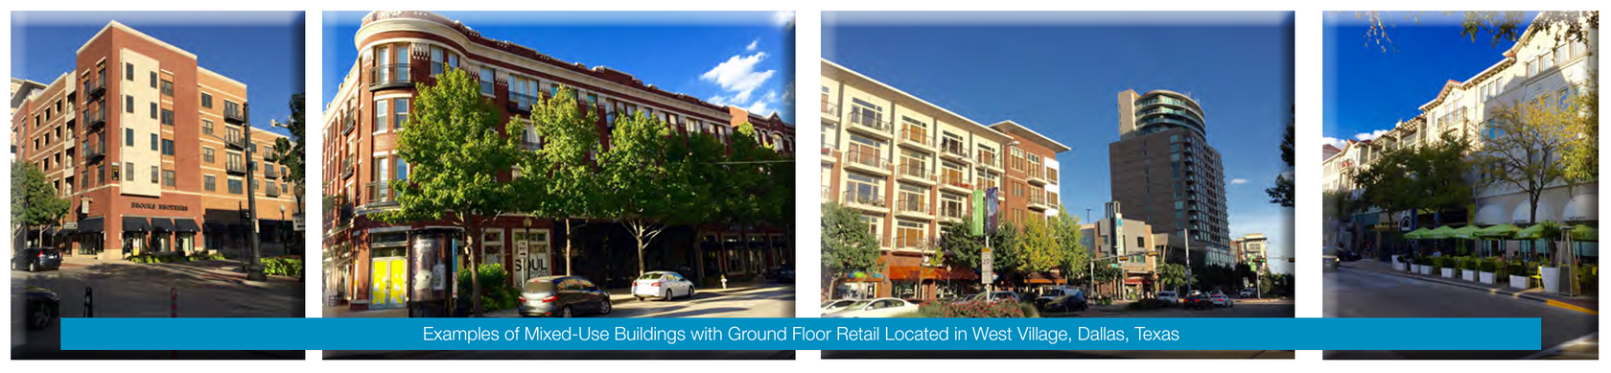
Preferred vision for preston center
The West Village area in Dallas is an example of the type of neighborhood envisioned here (but with significantly better access to public parking and much more green space). Based on the success of the initial, one-square-block development in West Village, the surrounding blocks have been developed in a similar format, with street level retail and restaurant spaces and compatible office projects.

Slide 24
Preferred vision for preston center
It is reasonable to assume that a similar expansion would, over time, happen in Preston Center. Recognizing that not all developments will be mixed use, the ultimate build out would undoubtedly include additional residential, retail, office and hospitality.

