Slide 1
Z190-002 Parking
Zoning Ordinance Advisory Committee (ZOAC)
8.6.2020
Lori Levy, AICP
Andreea Udrea, PhD, AICP
Senior Planners
Sustainable Development and Construction

Slide 2
Background
On September 5, 2019, City Plan Commission authorized a public hearing to consider amending Chapters 51 and 51A of the Dallas Development Code, with consideration to be given to amending off-street parking and loading requirements including, but not limited to, hotel, restaurant, multifamily, and alcoholic beverage establishment uses, and transit-oriented development.
ZOAC briefings:
3.5.2020
6.18.2020
7.9.2020
8.6.2020
D190-002

Slide 3
Index Cities/Other Cities Research
Austin
Baltimore
Boston
Columbus
El Paso
Fort Worth
Houston
Philadelphia
Phoenix
Tempe, Arizona
Portland
San Diego
San Jose
San Antonio
Seattle
San Francisco, Edmonton, Minneapolis
D190-002
Notes:
Parking are based on land use?
Majority of the cities (87%), parking is are based on the land use
Portland does not require parking and Boston is are based on Districts
Connected with transit system?
Cities are well connected with light-rail and bus transit. Except for the Columbus, all other cities are well connected with both light-rail/street car and bus.
Does your parking work?
General and tricky questions, majority of the cities answered their parking works, some indicated that it needs some improvements.
Do you have a special parking district?
Parking overlay districts
Parking management districts
Do you provide parking reductions?
Transit corridors districts
Parking reductions for adaptive reuse
Variance or administrative variance request
How long have you been operating under the current system?
1980 to 2018

Slide 4
Parking Regulations
Parking is generally regulated by municipalities in one or more of the following four ways:
Minimum Parking Requirements – the City determines the number of parking spaces that must be provided either are based on land uses and/or zoning or special districts, or
Open Option Parking – Businesses and homeowners can choose the amount of parking they provide, or
Maximum Parking Requirements – the City sets a limit on the number of parking spaces that can be provided, or
A combination of one or more
D190-002

Slide 5
Overview
18 out of 19 cities researched with minimum parking requirements
Atlanta • Austin • Baltimore • Boston • Columbus • El Paso • Fort Worth • Houston • Minneapolis • Philadelphia • Phoenix • Portland • San Antonio • San Diego • San Francisco • San Jose • Seattle • Tempe
16 out of 19 cities researched with maximum parking requirements
Atlanta • Austin • Baltimore • Boston • Columbus • El Paso • Fort Worth • Minneapolis • Phoenix • Portland • San Antonio • San Diego • San Francisco • San Jose • Seattle • Tempe
16 out of 19 cities researched with a combination of minimums and maximums
Atlanta • Austin • Baltimore • Boston • Columbus • El Paso • Fort Worth • Minneapolis • Phoenix • Portland • San Antonio • San Diego • San Francisco • San Jose • Seattle • Tempe
1 out of 19 cities researched with open option parking only
Edmonton, CANADA
D190-002

Slide 6
Cities Off-Street Parking Regulations Research
Atlanta, GA
Parking requirements are based on classification of land use and deviations to parking requirements are mainly authorized administratively by the Director of Planning.
Highlights:
No Minimum Parking Required for:
All uses within 2,640’ feet of a high capacity transit stop (p. 3 of staff report)
Parking Reductions:
0.5% per dwelling unit for housing for the elderly (p. 7 of staff report)
One on-street parking space for every off-street parking space immediately abutting subject property (p.19 - staff report)
Parking Requirements:
Off-street Surface Parking Lots shall not be located between a building and adjacent street with an intervening building
Austin, TX
Parking requirements are based on classification of land use and deviations to parking requirements are mainly authorized administratively by the Director of Planning.
Highlights:
No Minimum Parking Required for:
All uses in CBD or DMU (Downtown Mixed-Use) districts (p. 18 – staff report)
Parking Reductions:
Up to 10% by preserving significant stand of trees or protected trees
20 parking spaces for each car-share space provided
D190-002

Slide 7
Cities Off-Street Parking Regulations Research
Baltimore, MD
Parking requirements are based on classification of land use and deviations to parking requirements are mainly authorized administratively by the Director of Planning. Residential Parking Programs petitioned by residents are used to handle competition for parking demand.
Highlights:
No Minimum Parking Required for:
All non-residential uses within the R-MU and D-MU districts
Parking Reductions:
One space for every 2 dwelling units in dwellings rehabilitated or erected subject to restriction that the units to be leased to residents with incomes at or below 60% of area median income
0.5 per dwelling unit for units </- 500 sf
Parking Requirements:
Up to 25% for land banking a portion of land on the site to be held and preserved for open space for conversion into parking for future parking needs
Boston, MA
Parking requirements are calculated using maximum floor area ratio (FAR) for within land use categories within specific districts and deviations to parking requirements are mainly authorized administratively by the Director of Planning. Curb space is optimized by using Curb Management techniques used to analyze the parking supply and the off-street parking inventory by using Parking Districts, Development and Project Review, Resident Parking Programs and Neighborhood Business Districts.
Highlights:
No Minimum Parking Required for:
N/A – parking minimums apply except minor exemptions (reductions)
Parking Reductions:
No parking minimum for maximum FAR of 8.0 or 10.0
Parking Requirements:
Visitor parking with 2 hr. time limit in Restricted Parking Districts
D190-002

Slide 8
Cities Off-Street Parking Regulations Research
Columbus, OH
Parking requirements are based on classification of land use and deviations to parking requirements are mainly authorized administratively by the Director of Planning and through special parking districts.
Highlights:
No Minimum Parking Required for:
Art galleries in Short North Special Parking Area
Parking Reductions:
No minimum for retail </- 2, 500 sf in Short North Special Parking Area
One-half of parking required for non-residential uses in Short North Special Parking Area
Parking Requirements:
Two bicycle parking spaces for multi-family, restaurants, hotels and schools
Edmonton, CAN
Parking minimums have been removed in Edmonton, Canada and has been replaced with Open Option Parking which allows homeowners and businesses to choose the amount of parking they provide on their property. On-street parking meters and residential parking permits are managed by the City to provide on-street parking.
Highlights:
No Minimum Parking Required for:
Any use or district within Edmonton
Parking Reductions:
N/A – No minimums required
Parking Requirements:
Design standards for parking garages (Above Ground Parkades), surface parking lots and underground parking (p. 27 - staff report)
D190-002

Slide 9
Cities Off-Street Parking Regulations Research
El Paso, TX
Parking requirements are based on classification of land use and deviations to parking requirements are mainly authorized administratively by the Director of Planning. Parking Benefit Districts are used in which curbside parking spaces or public, city parking facilities are in designated areas and funds from that district are used to fund improvements within the district.
Highlights:
No Minimum Parking Required for:
N/A
Parking Reductions:
Shared Parking for uses with different hours of operation
Up to a one hundred percent reduction for a use involving the new construction of a structure(s) that is proposed as a redevelopment project located within a redevelopment area
Fort Worth, TX
Parking requirements are based on classification of land use and deviations to parking requirements are mainly authorized administratively by the Director of Planning.
Highlights:
No Minimum Parking Required for:
All uses in CBD “H” District (p. 17 and 15, respectively - staff report) or any uses not within 250’ of a residential 1 or 2-family zoned property
Parking Reductions:
25% for conversion from a more restricted use to a restaurant (p. 11 - staff report)
25% for multi-family uses within the MU-1 or MU-2 Mixed-Use Districts
Parking Requirements:
Maximum parking cannot exceed 125% of minimum required unless 1 tree above minimum required (p. 15 - staff report)
D190-002

Slide 10
Cities Off-Street Parking Regulations Research
Houston, TX
Parking requirements are based on classification of land use and deviations to parking requirements are mainly authorized administratively by the Director of Planning. Residents can petition a neighborhood for a Residential Parking Permit Area. City Council may designate such areas by ordinance if the Council determines that there is a “chronic commuter parking problem”, or occupancy is high for curbside parking by commuter vehicles at the same hours on the same days.
Highlights:
No Minimum Parking Required for:
N/A (This research does not include TOD areas which may provide no minimums)
Parking Reductions:
Up to 20 on-street spaces may be counted for Car-Share Houston
One parking space for each 4 additional bicycle spaces in addition to the minimum number of bicycle spaces required
Minneapolis, MN
Parking requirements are based on classification of land use and deviations to parking requirements are mainly authorized administratively by the Public Works Department.
Highlights:
No Minimum Parking Required for:
Restaurant, hotels, and schools in the Downtown District or multi-family uses (note visitor parking requirement if parking is provided and >/- 50 dwelling units)
Parking Reductions:
No minimum for non-residential uses </-1,000 sf
Parking Requirements:
Conditional Use Permit required for parking in excess of minimums
D190-002

Slide 11
Cities Off-Street Parking Regulations Research
Philadelphia, PA
Parking requirements are based on classification of land use and deviations to parking requirements are mainly authorized administratively by the Director of Planning.
Highlights:
No Minimum Parking Required for:
Restaurants or hotels in commercial districts
Parking Reductions:
Parking requirements exempted for designated historic buildings or structures in designated historic districts
Delaware River Waterfront Parking for sit-down restaurants at 1/4 occupants and nightclubs at 1/2 occupants
Parking Requirements:
A bioretention system that is designed in accordance with the Philadelphia Stormwater Management Guidance or curbing to allow drainage from pavement to enter to percolate is required for interior landscaping.
Phoenix, AZ
Parking requirements are based on classification of land use and deviations to parking requirements are mainly authorized administratively by the Director of Planning and Development, Building Inspector and Traffic Engineer through Parking Management Plans. On-street Parking Zones may be requested by residents and business owners experiencing intruder parking in front of establishments by petition. Parking Management Studies are required for all new construction or expansion of existing buildings.
Highlights:
No Minimum Parking Required for:
All uses in Downtown Core and Warehouse District
Parking Reductions:
10 parking spaces for permanent public art detached from the building developed by a commercial artist that occupies a minimum of 10 cu feet
4 parking spaces for every 50 sf of improved outdoor public plazas or courtyards with seating integrated and adjacent with main circulation
D190-002

Slide 12
Cities Off-Street Parking Regulations Research
Portland, OR
Parking requirements are based on classification of land use and deviations to parking requirements are mainly authorized administratively by the Director of Planning. Parking Management Districts for residents and businesses help to manage curb space by varying times available and provide flexibility for visitors to park at meters.
Highlights:
No Minimum Parking Required for:
Properties within 1,500’ feet of a light rail station or within 500’ feet of a frequent transit stop or multi-family with </- 30 dwelling units
Parking Reductions:
Up to 5 spaces or 5%, whichever is less, may be substituted for motorcycle parking
1 space for each 12” diameter or larger tree preserved, up to 50%
Parking Requirements:
50% of required long-term bicycle parking spaces must be covered
San Antonio, TX
Parking requirements are based on classification of land use and deviations to parking requirements are mainly authorized administratively by the Director of Development Services. Traffic Control Districts are used to control parking in and around large facilities that attract large amounts of vehicular traffic and to regulate parking of vehicles.
Highlights:
No Minimum Parking Required for:
For all uses within the Urban Development District and the Infill Development Zone
Parking Reductions:
Up to 50% for preservation of woodlands or a significant stand of trees in a natural state
Exemptions for parking requirements for specified non-residential uses, such as helistop, moving companies, limousine dispatch, freight depots, public and private golf courses, and accessory uses
D190-002

Slide 13
Cities Off-Street Parking Regulations Research
San Diego, CA
Parking requirements are based on classification of land use and deviations to parking requirements are mainly authorized administratively by the Director of Neighborhood Development. Special Districts, such as the Parking Impact Overlay Zone is used to control coastal beach and campus areas that have parking impacts. The Metropolitan Transit Development Board (MTDB) along with the City Council use funds from the Centre City Transit and Parking Improvement Fund to fund improvements for parking within the Centre City and to support transit and parking needs of the Centre City Community Plan.
Highlights:
No Minimum Parking Required for:
All uses within the Transit Priority Areas
Parking Reductions:
For very low income, low income, moderate income or senior households, transitional foster youth, disabled veterans, or homeless persons
Small lots without alley access are exempt from parking minimums (p. 17 - staff report)
Parking Requirements:
Unbundled Parking (p. 13 - staff report)
San Francisco, CA
Parking requirements are based on classification of land use and deviations to parking requirements are mainly authorized administratively by the Director of Planning and Development. Special Districts have specific parking requirements and all areas of the city have parking maximums to control excess parking.
Highlights:
No Minimum Parking Required for:
Restaurants, hotels, schools and post-secondary schools
Parking Reductions:
Parking only required for major additions to structures and uses
Parking Requirements:
Car Share spaces (p. 25-26 – staff report)
D190-002

Slide 14
Cities Off-Street Parking Regulations Research
San Jose, CA
Parking requirements are based on classification of land use and deviations to parking requirements are mainly authorized administratively by the Director of Planning. TDM programs are required for reductions, and Parking Plans when specified. A Transportation Management Program (TDM) is a program that is used to provide evidence that the program will reduce parking demand and identifies the percentage of parking demand that will be reduced through the TDM.
Highlights:
No Minimum Parking or Loading Required for:
Additions to historic landmark or structures in historic district (p. 10 – staff report)
Parking Reductions:
Up to 50% may be tandem parking spaces are based on adequate Parking Plan which may include, alternate peak use of parking, shared parking or proximity to public transit (p. 8 - staff report)
Up to 50% with a TDM program that provides evidence that demand will be reduced and will include 3 TDM measures (p. 21 - staff report)
Seattle, CA
Parking requirements are based on classification of land use and deviations to parking requirements are mainly authorized administratively by the Director of Department of Neighborhoods. Special Review Districts approved by the City Council are used to control parking in specific districts. A Special Review Board or the Director reviews application requests and makes recommendations for deviations to parking requirements for new multi-family, commercial or major institution uses.
Highlights:
No Minimum Parking Required for:
Non-residential uses, in the Urban Center, Station Area Overlay, Frequent Transit Area or MR and HR Districts, except hospitals (p. 8 – staff report)
Parking Reductions:
College/Universities within single-family districts in Urban Villages are exempt from parking requirements
Parking Requirements:
No surface parking lots or flex use parking lots for parking greater than 145 spaces
D190-002

Slide 15
Cities Off-Street Parking Regulations Research
Tempe, AZ
Parking requirements are based on classification of land use and parking is mostly managed administratively by the Zoning Administrator. Alternative parking requests require a Parking Demand Study and Use Permits are required for exceeding parking maximums. Special Districts, such as the Downtown District require Parking Management Plans.
Highlights:
No Minimum Parking Required for:
N/A
Parking Reductions:
Off-Site parking may be used within 1,320 sf of the use
Restaurants, bars, and clubs in Downtown District are exempt from parking requirements for the first 5,000 sf and counted as 1/500 sf thereafter; also net square footage excludes hallways, restrooms, kitchens and storage areas (p. 18 - staff report)
Parking Requirements:
Parking as a principal use is prohibited in the Station Area
D190-002

Slide 16
Summary/Findings
Allowances for parking reductions are typically greatest for uses located within the nearest proximity to transit.
No parking minimums are predominately used in a few specific areas with well established transit nearby, and within specific land use categories; and, also include techniques to manage the parking demand and supply.
Parking reductions are incentivized and are based on stated community vision statements and goals articulated in general plans.
D190-002

Slide 17
Parking Code Amendment webpage
Webpage:
https://dallascityhall.com/departments/sustainabledevelopment/planning/Pages/Code-Amendments.aspx
Interested Parties can signup at parkingcode@dallascityhall.com
D190-002

Slide 18
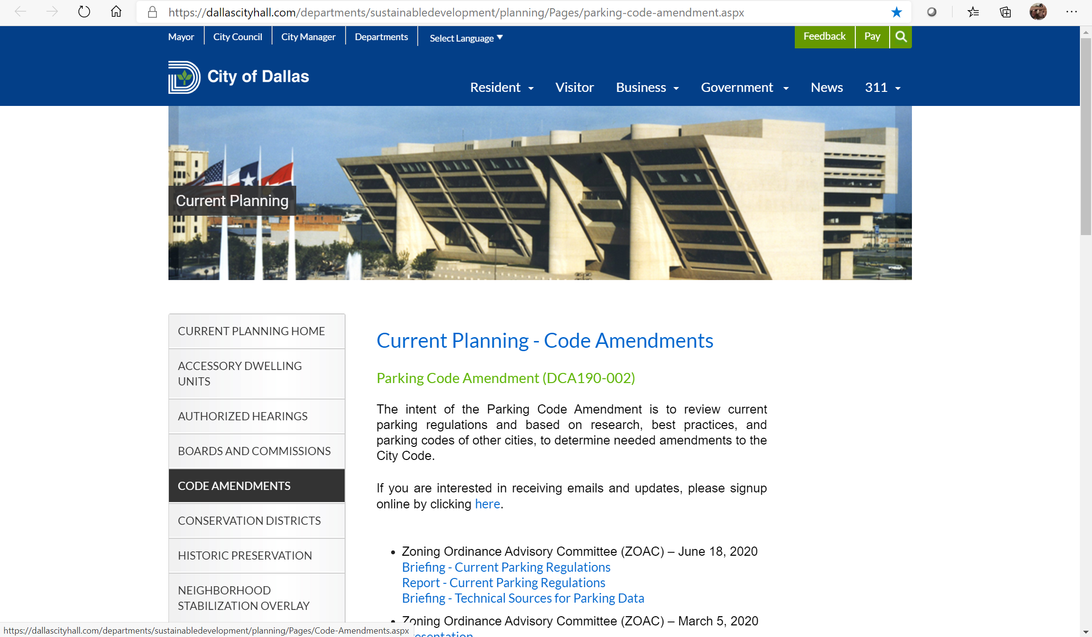
D190-002

Slide 19
Z190-002 Parking
Zoning Ordinance Advisory Committee (ZOAC)
7.9.2020
Sustainable Development and Construction

