Slide 1
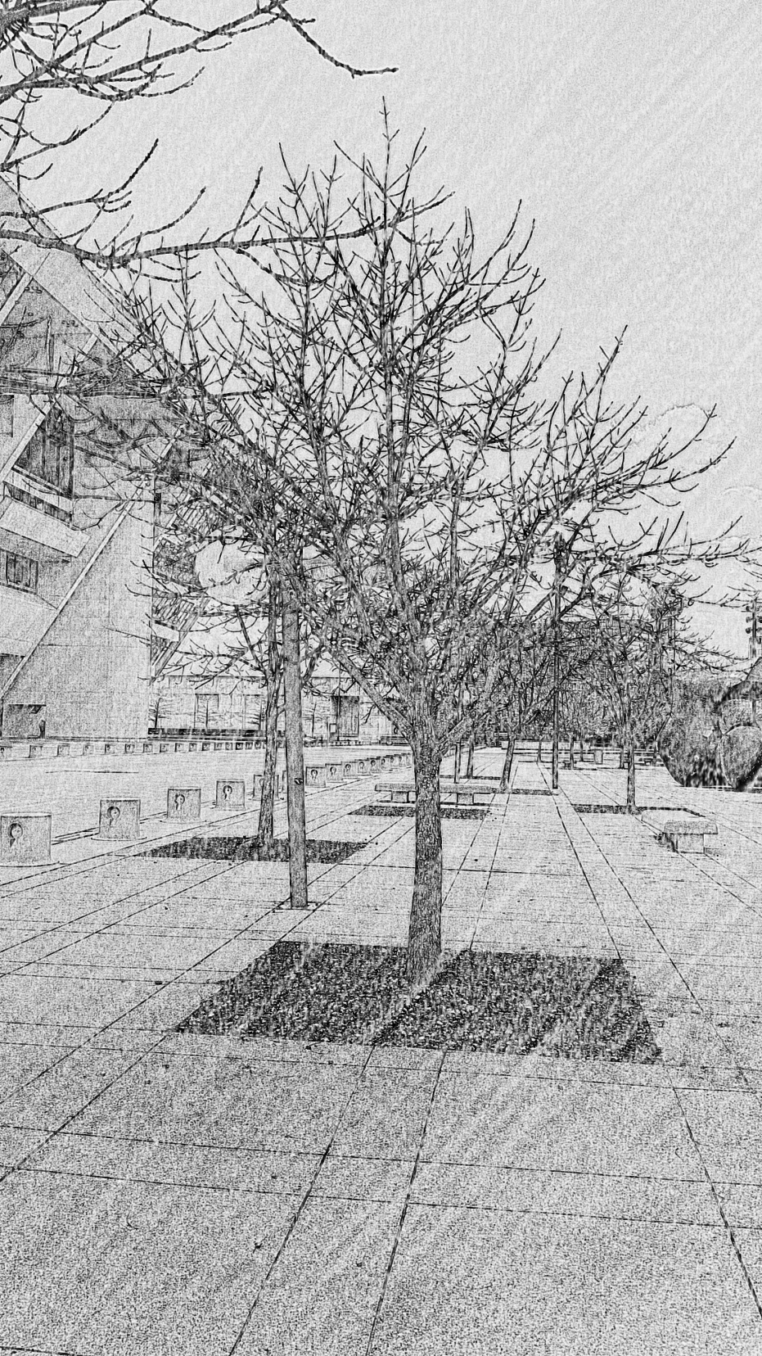
ARTICLE X
LANDSCAPE AND TREE CONSERVATION REGULATIONS
IN GENERAL – Division 51A-10.100
LANDSCAPING – Division 51A-10.120
City Plan Commission Briefing – June 8, 2017

Slide 2
PURPOSE STATEMENT
The process of urban growth and development with its alteration of the natural topography, vegetation, and creation of impervious cover can have a negative effect on the ecological balance of an area by causing increases in air temperatures and accelerating the processes of runoff, erosion and sedimentation. The economic base of the city can and should be protected through the conservation preservation and enhancement of the unique natural beauty, environment, and vegetative space in this area. Recognizing that the general objectives of this article are to promote and protect the health, safety, and welfare of the public, the city council further declares that this article is adopted for the following specific purposes:

Slide 3
PURPOSE STATEMENT
To aid in stabilizing the environment’s ecological balance by contributing to the processes of air purification, oxygen regeneration, ground-water recharge, and storm water runoff retardation and filtration while at the same time aiding in noise, glare, wind, and heat abatement.
To provide visual buffering between land uses of differing character to alleviate the harshness of urban life.
To enhance the beautification of the city.
To safeguard property values and to protect public and private investment.
To conserve energy.
To provide habitat for wildlife.
To encourage the preservation of large trees which,
once removed, can be replaced only after generations.
To conserve water.
To recognize and conserve the urban forest as part of the city’s green infrastructure.

Slide 4
APPROACH
Address current and future social and environmental concerns regarding public health, air, water, and sustainable growth.
Maintain structure of ordinance for continuity with past PD’s.
Provide broader parameters and more tools for adaptability which can be applied in future PD’s without amendment, and to amend for administrative conflicts in the ordinance.
Complement regulations and enforcement with a landscape and tree maintenance guide for homeowners and developers.
Adopt uniform standards for best management practices and conform to recognized soil volume requirements based on knowledge derived from decades of peer-reviewed research.
Apply sustainable development standards by recognizing all costs and benefits and by seeking balanced solutions.

Slide 5
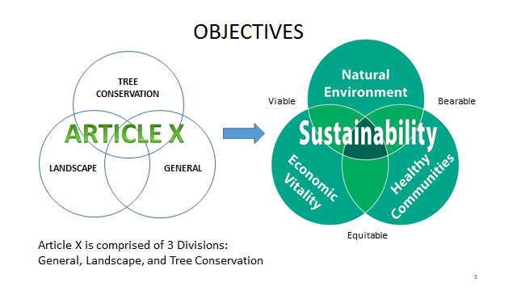
Sustainable Development

Slide 6
ARTICLE X
LANDSCAPE AND TREE CONSERVATION PRESERVATION REGULATIONS
Division 51A-10.100. In General
Division 51A-10.120. Landscaping
Division 51A-10.130. Urban Forest Conservation
Tree Preservation, Removal, and Replacement

Slide 7
IN GENERAL
(10.100)
Existing
Proposed
.101 Definitions
.102 Purpose
.103 Acceptable Plant Material
.104 Planting Area Requirements
.105 Protection of Planting Areas
.106 Irrigation Requirements
.107 Planters allowed
.108 General Maintenance
.109 References
.110 Special Exception
.101 Definitions
.102 Purpose
.103 Acceptable Plant Material
.104 Soil and Planting Area Requirements
.105 Protection of Planting Areas
.106 Irrigation Requirements
.107 Planters allowed
.107.1 Pedestrian Pathways
.108 General Maintenance
.109 Landscape and Tree Manual
.110 Special Exceptions

Slide 8
IN GENERAL
(10.100)
.101 Definitions
.102 Purpose
.103 Acceptable Plant Material
.104 Soil and Planting Area
Requirements
.105 Protection of Planting Areas
.106 Irrigation Requirements
.107 Planters allowed
.107.1 Pedestrian Pathways
.108 General Maintenance
.109 Landscape and Tree Manual
.110 Special Exceptions
Definitions added and/or amended (10.101)
Purpose statement amended: focus on conservation, address water conservation and green infrastructure (10.102)
Restricted artificial and invasive plants from meeting landscape requirements, associated acceptable plant materials will be listed separately in the Manual (10.103)
Soil and planting area requirements were significantly amended to specify general and alternative soil conditions, and to establish planting distances and restrictions (10.104)

Slide 9
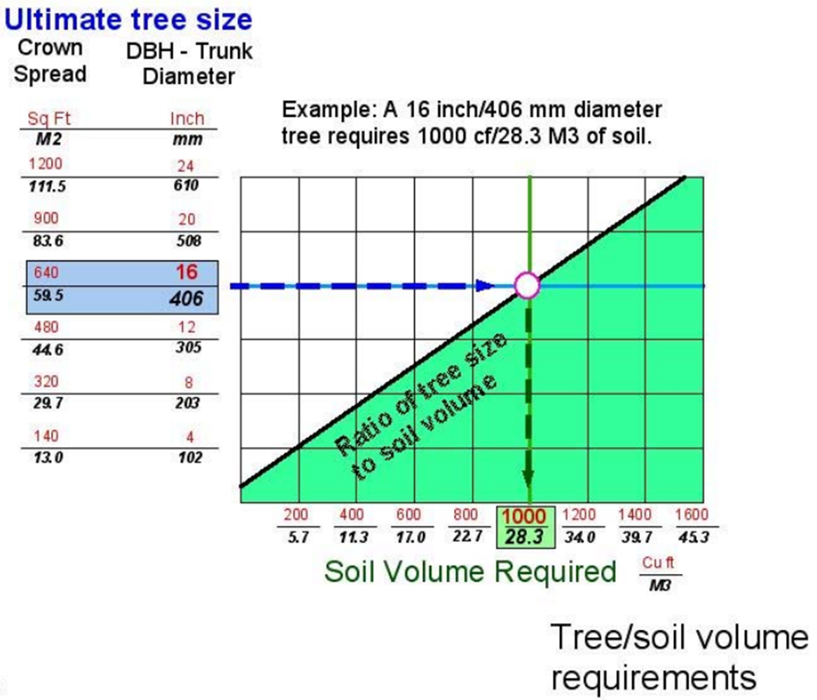
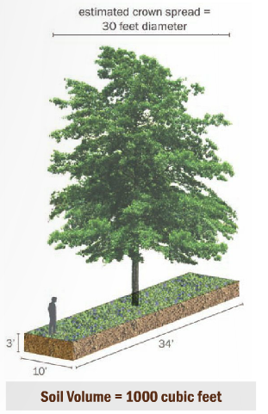
IN GENERAL
(10.104)
Chart: James Urban, (Up By Roots, ISA Press, 2008)
Casey Trees

Slide 10
IN GENERAL
(10.100)
.101 Definitions
.102 Purpose
.103 Acceptable Plant Material
.104 Soil and Planting Area
Requirements
.105 Protection of Planting Areas
.106 Irrigation Requirements
.107 Planters allowed
.107.1 Pedestrian Pathways
.108 General Maintenance
.109 Landscape and Tree Manual
.110 Special Exceptions
Irrigation requirements were amended (10.106)
Specified ‘pedestrian pathways’ when determining application for landscaping (10.107.1)
Landscape and Tree Manual as a technical guide and educational source to the ordinance (10.109)
Amended factors to be considered in tree conservation regulation special exceptions (10.110)

Slide 11
LANDSCAPING
(10.120)
Existing
Proposed
.121 Application of Division
.122 Artificial Lot Determination
.123 Landscape Plan Submission
.124 Landscape Plan Review
.125 Mandatory Landscape Requirements
.126 Design Standards
.127 When landscape must be completed
.128 Enforcement by Building Official
.121 Application of Division
.122 Artificial Lot Determination
.123 Landscape Plan Submission
.124 Landscape Plan Review
.125 Mandatory Landscape Requirements
.126 Design Options Standards
.127 When landscape must be completed
.128 Enforcement by Building Official

Slide 12
LANDSCAPING
(10.121, 10.122, 10.123, 10.124)
.121 Application of Division
.122 Artificial Lot Determination
.123 Landscape Plan Submission
.124 Landscape Plan Review
.125 Mandatory Landscape
Requirements
a) Single family uses
b) Other uses
1) Street Buffer Zones
2) Residential Buffer Zones
3) Interior Zones
.126 Design Options Standards
.127 When landscape must be completed
.128 Enforcement by Building Official
Adjusted the application of the division (10.121)
Required landscaping requirements in PDs to comply with the General Division requirements (10.121)
Amended areas to be included in artificial lots (10.122)
Required identification of utilities and other site elements, and landscape plan preparation requirements (10.123)
Allowed for minor landscape plan modification (10.124)

Slide 13
Single Family and Duplex Uses (10.125(a))
.121 Application of Division
.122 Artificial Lot Determination
.123 Landscape Plan Submission
.124 Landscape Plan Review
.125 Mandatory Landscape Requirements
a) Single family and duplex uses
b) Other uses
1) Street Buffer Zone
2) Residential Buffer Zone
3) Interior Zone
.126 Design Options Standards
.127 When landscape must be
completed
.128 Enforcement by Building Official
Landscape tree requirements for single family construction amended for builder tree installation to be based on lot size and restrict planting to be away from utilities (10.125(a))
Shared Access Development landscaping amended to provide one standard of landscaping for all scales of development for all zoning districts, with application of plant groups along the street front (10.125(a))

Slide 14
SF and Duplex Uses (including Shared Access Development) (10.125(a))
SF / D - Current ordinance
SF / D - Proposed ordinance
All single family and duplex lots require:
  3 trees per lot from Approved Replacement Tree List
  2” caliper, or an existing tree on list
  Two trees in front yard
Lots 7,500 sf or greater:
  3 large or medium trees with 2 in front yard
Lots 4,000 sf to 7,499 sf:
  2 large or medium trees with 1 in front yard
Lots 4,000 sf or less:
  1 large or medium tree on lot
2” caliper, or an existing tree in front yard/parkway
No closer than 20’ from utility

Slide 15
SF and Duplex Uses (including Shared Access Development) (10.125(a))
Shared Access Development - Current Ordinance
Shared Access Development -Proposed Ordinance
Two standards: SF districts and other than SF districts
SF districts – street front LA with three trees per lot, 2 in common front yard
Other – 1 tree per 4,000 sf, 20% landscape area, plus provide street trees
One standard for all sizes up to 36 individual lots in SAD
Minimum landscape area determined by # of lots:
  Up to 10 lots = minimum of 10% of SAD
  11 to 36 lots = minimum of 15% of SAD
1 tree per 4,000 sf of SAD, including street plant groups at 1 per 40 ft. of street frontage

Slide 16
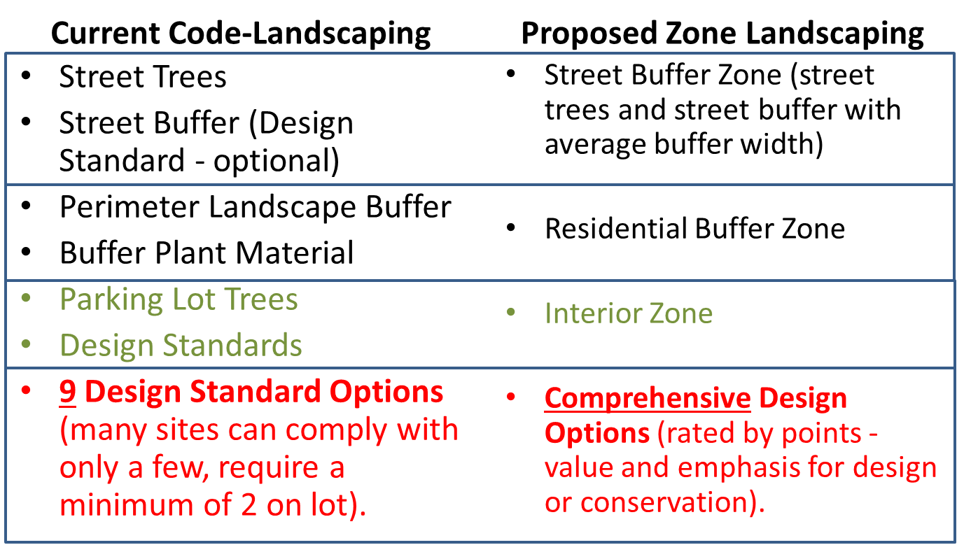
Other Uses
(10.125(b))

Slide 17
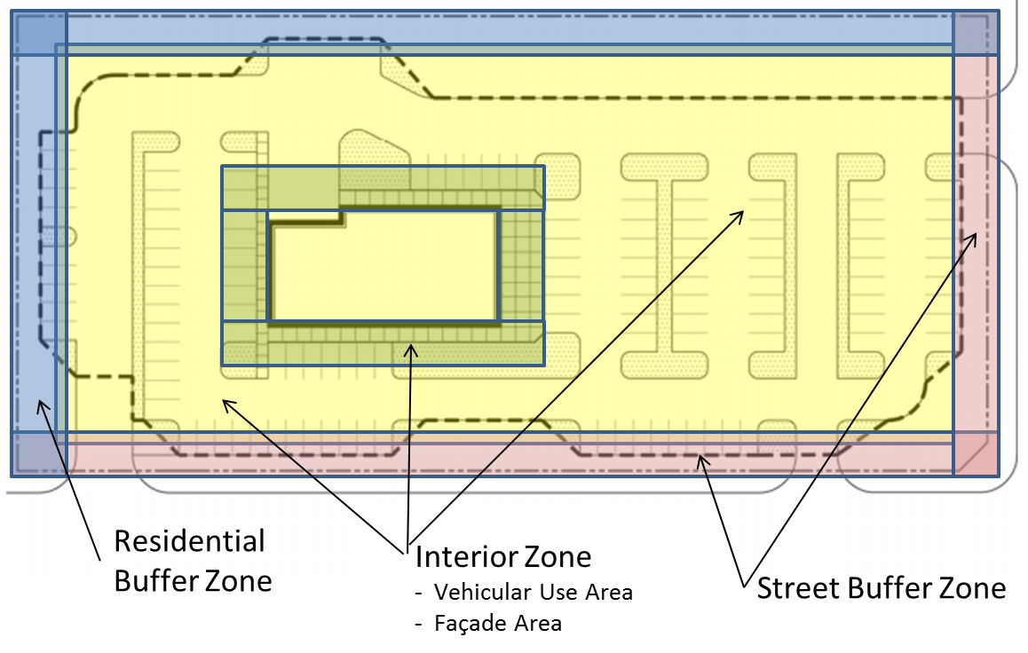
Zone Landscape
(10.125(b))

Slide 18
Street Buffer Zone
(10.125(b)(1))
.121 Application of Division
.122 Artificial Lot Determination
.123 Landscape Plan Submission
.124 Landscape Plan Review
.125 Mandatory Landscape Requirements
a) Single family and duplex uses
b) Other uses
1) Street Buffer Zone
2) Residential Buffer Zone
3) Interior Zone
.126 Design Options Standards
.127 When landscape must be completed
.128 Enforcement by Building Official
Other uses amended to provide adjustable mandatory landscape requirements based on site and street restrictions (10.125(b))
Created a Street Buffer Zone (SBZ) with an average (variable) depth requirement along street frontages, average depth based on street types - freeway, arterials/community collectors, and local/residential collectors (10.125(b)(1))
Provided for an urban streetscape alternative to the SBZ for Mixed Use development types (10.125(b)(1)(A))
Provided for modification of the SBZ when using right-of-way, subject to conditions (10.125(b)(1)(B))
Provided for a plant size modification when utilities prohibit planting large or medium trees (10.125(b)(1)(C))
Provided for a reduced SBZ for lots smaller than 10,000 square feet (10.125(b)(1)(D))

Slide 19
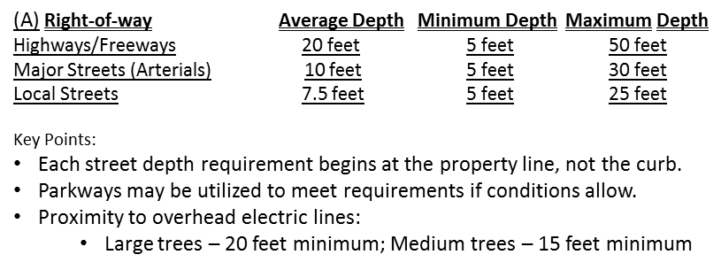
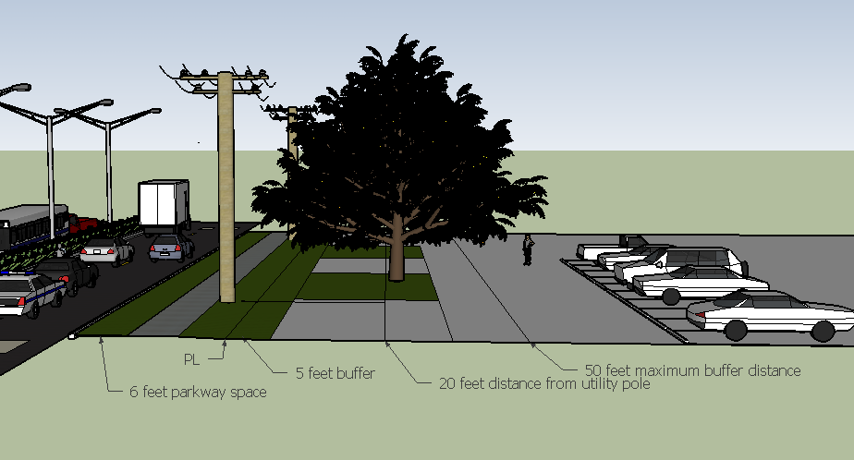
Street Buffer Zone
(10.125(b))
20 feet to
Electric line
6’ planting
depth
PL
10’ Avg. Depth
Arterial Street
Large tree
5’ Min.
Depth
30’ Max.
Depth
Parkway

Slide 20
Residential Buffer Zone
(10.125(b)(2))
.121 Application of Division
.122 Artificial Lot Determination
.123 Landscape Plan Submission
.124 Landscape Plan Review
.125 Mandatory Landscape Requirements
a) Single family and duplex uses
b) Other uses
1) Street Buffer Zone
2) Residential Buffer Zone
3) Interior Zone
.126 Design Options Standards
.127 When landscape must be completed
.128 Enforcement by Building Official
Residential Buffer Zone (RBZ), replacing “perimeter landscape buffer strip”, having an average (variable) depth requirement where residential adjacency exists (10.125(b)(2))
RBZ must be an average 10 feet deep, but not less than 5 feet deep and no more than 30 feet deep at any point (10.125(b)(2))
Plant groups are required with a prohibition of planting large or medium trees within close proximity to utility lines (10.125(b)(2))

Slide 21
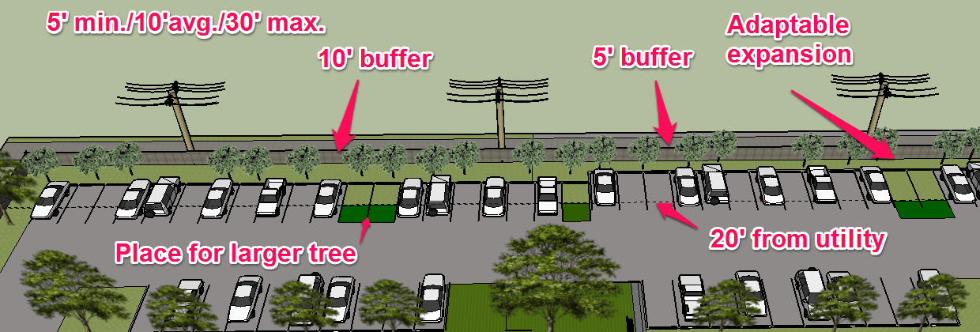
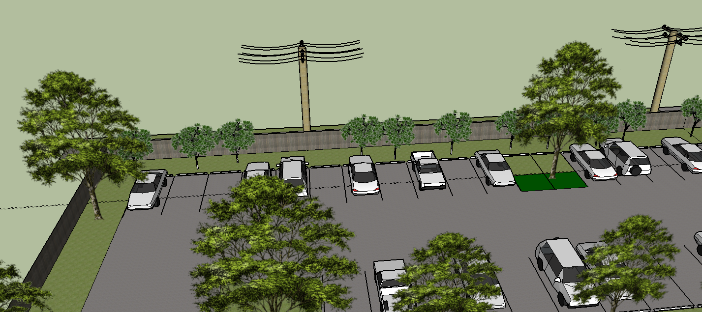
Residential Buffer Zone
(10.125(b)(2))

Slide 22
Interior Zone
(10.125(b)(3)(A))
Interior Zone to include Parking Lots (10.125(b)(3)(A))
Parking lot landscape areas must have at least 160 square feet soil area with 3” trees a minimum of four feet from pavement (10.125(b)(3)(A))
Parking lot requirements amended based on the number of parking spaces:
  21-100 spaces – no space located more than 70 feet from the trunk of a large or medium tree
  Greater than 100 spaces - A parking island landscape area must be at the end of a single row of spaces with at least 1 tree, maximum number of spaces between parking island landscape areas is 12 spaces, except where a median landscape area or buffer adjoins the spaces.
.121 Application of Division
.122 Artificial Lot Determination
.123 Landscape Plan Submission
.124 Landscape Plan Review
.125 Mandatory Landscape Requirements
a) Single family and duplex uses
b) Other uses
1) Street Buffer Zone
2) Residential Buffer Zone
3) Interior Zone
.126 Design Options Standards
.127 When landscape must be completed
.128 Enforcement by Building Official

Slide 23
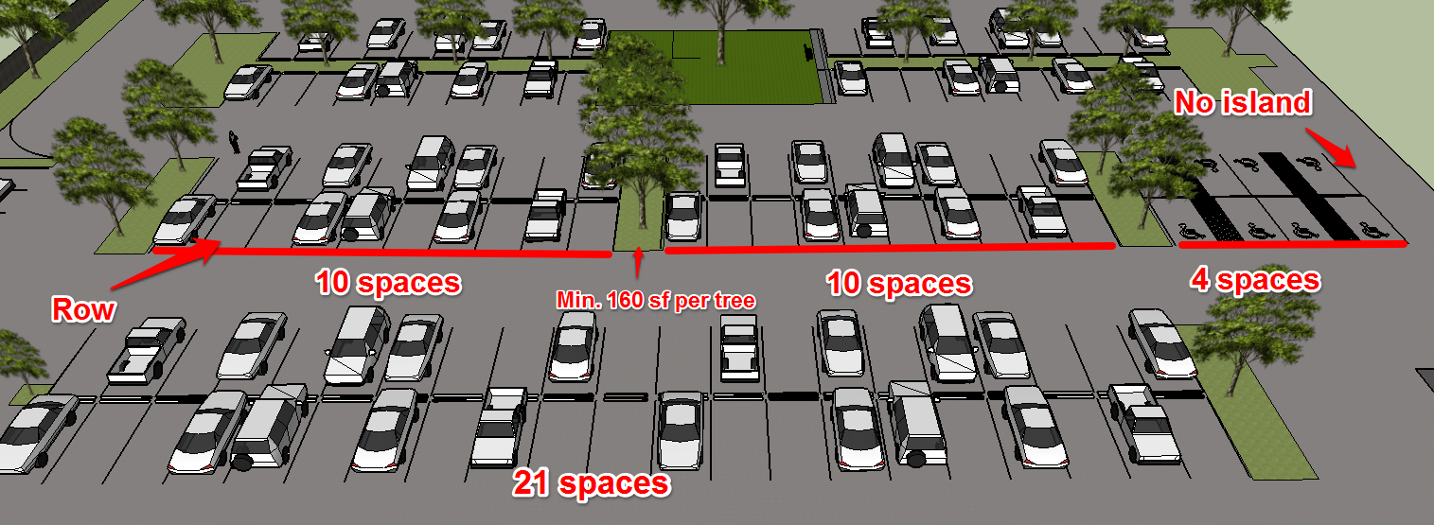
Interior Zone
(10.125(b))
Proposed
Current
Code

Slide 24
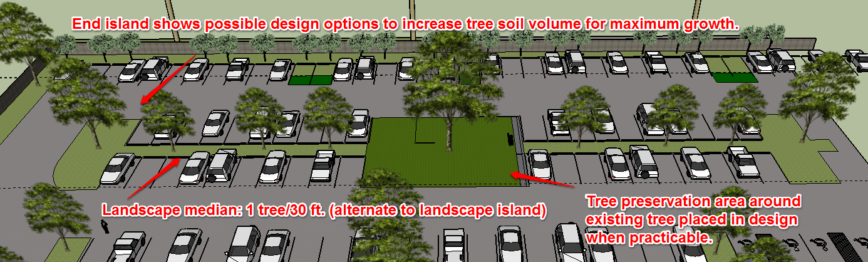
Interior Zone
(10.125(b))

Slide 25
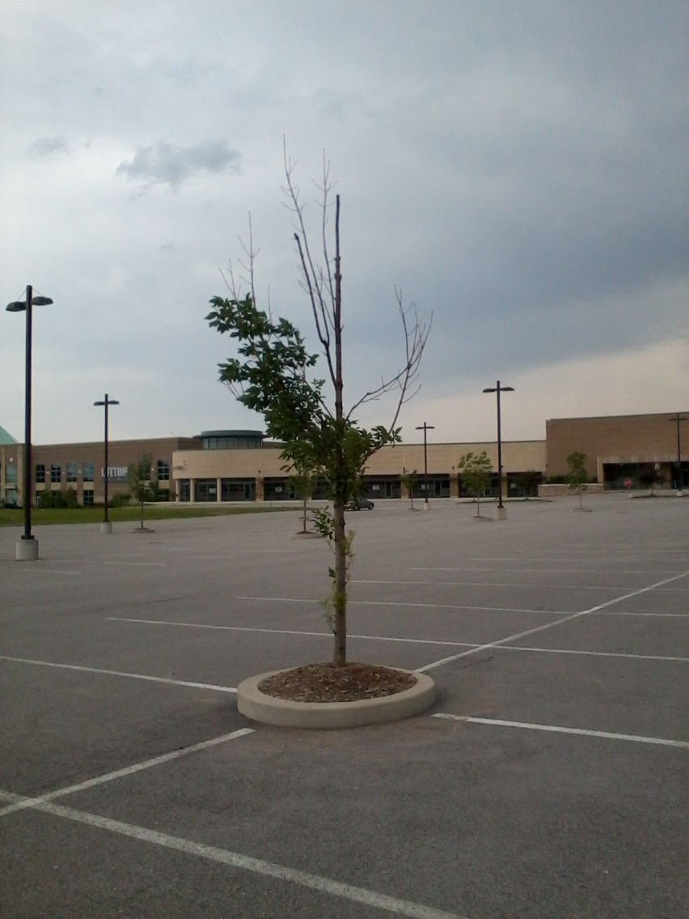
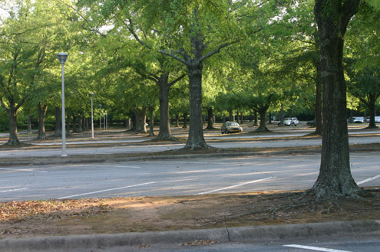
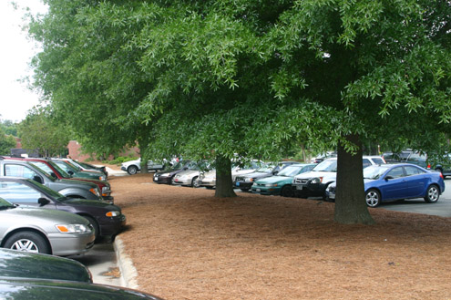
Interior Zone
(10.125(b))

Slide 26
Design Options
(10.126)
Design Options, replacing “Design Standards”, are more adaptable and versatile (10.126)
Design Option point system was created on a scale from 0 to 50, and scaled for increasing property size (10.126)
Design Options are available in a number of areas to allow for the enhancement of site landscapes and site sustainability (10.126)
  Plant material bonus points
  Buffer zone enhancements
  Engineered solutions for soil volume
  Screening
  Building façade
  Pedestrian uses
  Pavements
  Conservation
  Low impact development
  Parking lots
  General
.121 Application of Division
.122 Artificial Lot Determination
.123 Landscape Plan Submission
.124 Landscape Plan Review
.125 Mandatory Landscape Requirements
a) Single family and duplex uses
b) Other uses
1) Street Buffer Zone
2) Residential Buffer Zone
3) Interior Zone
.126 Design Options Standards
.127 When landscape must be completed
.128 Enforcement by Building Official

Slide 27
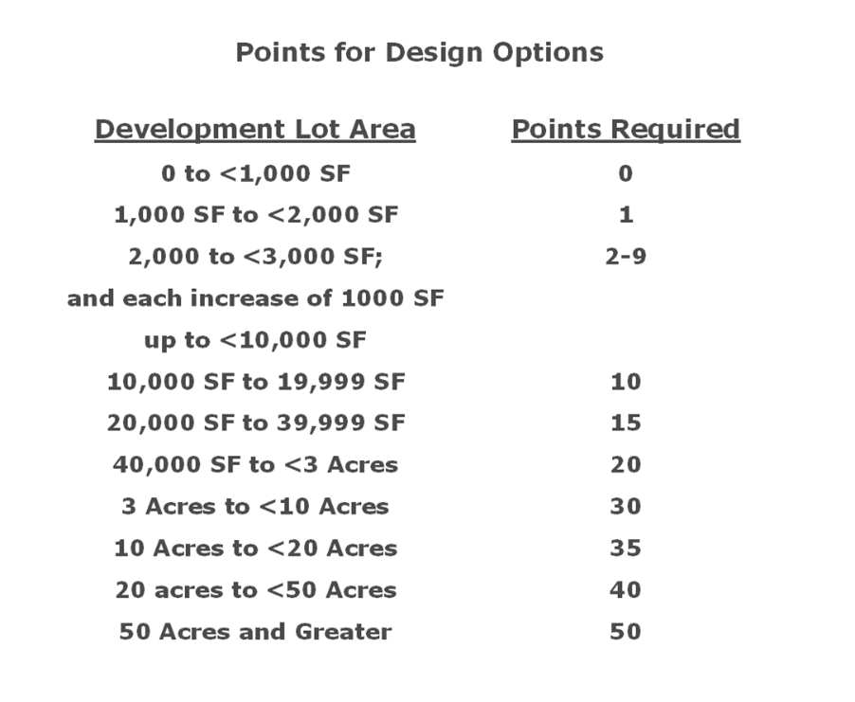
Design Options
(10.126)

Slide 28
Design Options
(10.126)
Design Options are available in a number of areas to allow for the enhancement of site landscapes and site sustainability (10.126)
  Plant material bonus points
  Buffer zone enhancements
  Engineered solutions for soil volume
  Screening
  Building façade
  Pedestrian uses
  Pavements
  Conservation
  Low impact development
  Parking lots
  General

Slide 29
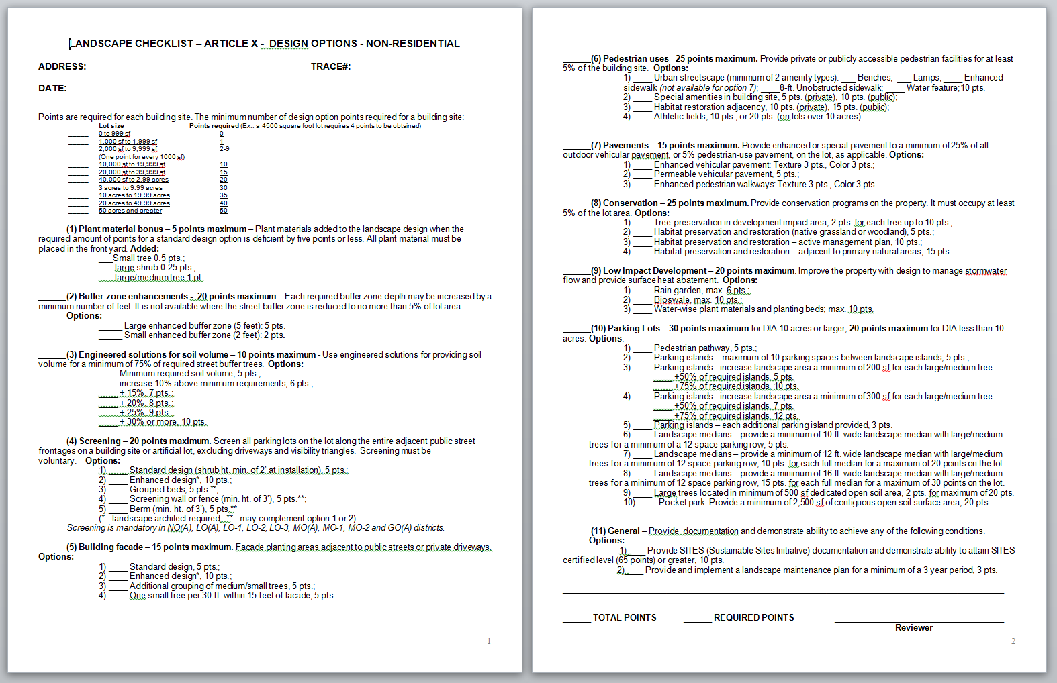
Design Options
(10.126)

Slide 30
LANDSCAPING
(10.127, 10.128)
Conditions of 10.127 and 10.128 have not been amended.
Landscaping must be completed before a final certificate of occupancy. A time extension is possible with required documentation.
As was amended in 2003, projects may be interrupted by an order to stop work if violations occur. This same provision is located for tree regulations in 10.137.
.121 Application of Division
.122 Artificial Lot Determination
.123 Landscape Plan Submission
.124 Landscape Plan Review
.125 Mandatory Landscape Requirements
a) Single family and duplex uses
b) Other uses
1) Street Buffer Zone
2) Residential Buffer Zone
3) Interior Zone
.126 Design Options Standards
.127 When landscape must be completed
.128 Enforcement by Building Official

Slide 31
CONCLUSION
The landscape provisions have been upgraded to apply reasonable standards while considering the size of the property, the zoning demands for the use, relative costs for site enhancement, and the location of existing infrastructure.
The urban forest conservation division has been adapted to apply landscape design options for sites which are also impacted by tree replacement requirements.
We will next discuss multiple methods in which developments can REDUCE their tree mitigation burden while also providing innovative avenues for applying tree mitigation CREDIT by planting for the ‘projected growth’ of trees and seeking tree canopy cover goals through both planting ‘legacy trees’ and by preserving existing ones.

Slide 32
SCHEDULE
June 22, 2017 CPC Briefing and Agenda item for Public Input
July 20, 2017 CPC Briefing and Agenda item for Action
Link to webpage:
http://dallascityhall.com/departments/sustainabledevelopment/planning/Pages/Code-Amendments.aspx
Phil Erwin, Chief Arborist philip.erwin@dallascityhall.com
Donna Moorman, Chief Planner donna.moorman@dallascityhall.com

