Slide 1
Urban Design Committee
Preston Center Area Plan Overview

Slide 2
Presentation Overview
Preston Center Area Plan Background
  Consultants Role
  Advisory Task Force (ATF) Plan
Facilitated Discussion on the Plan

Slide 3
Background: Project Start
Initial Town Hall Meeting
Establish Task Force and Define Scope
Hire Consultants
Start the Planning
October 2014
March 2015
June 2015
July 2015

Slide 4
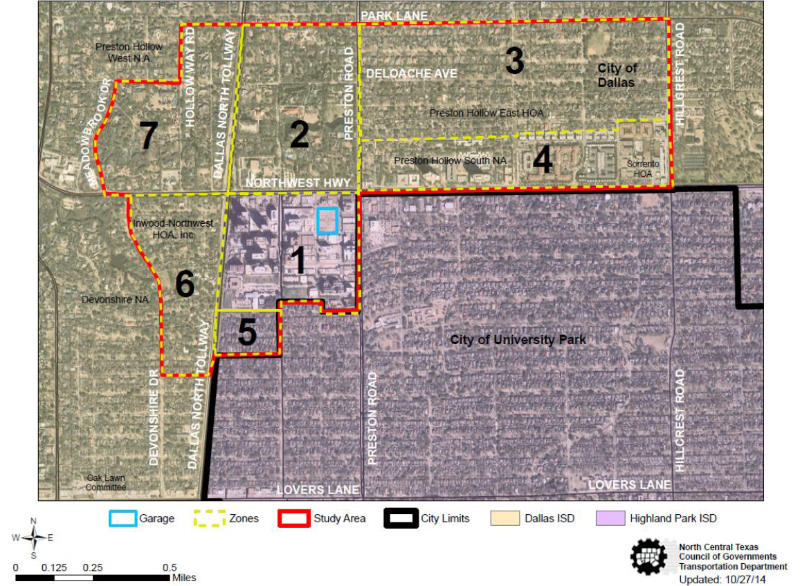
Background: Preston Center Plan Area

Slide 5
Task Force Members
Zone 1 | Zone 4
William Willingham | Patti Niles
Leland Burk | J. Steve Dawson
Bill Archer | Zone 5
Mark Roppolo | Betsy Del Monte
Zone 2 | Zone 6
J. Baxter Brinkmann | Maureen McCaffrey
Peter Kline | Zone 7
Zone 3 | Laura Miller
Jay Grogan
Ashley Parks

Slide 6
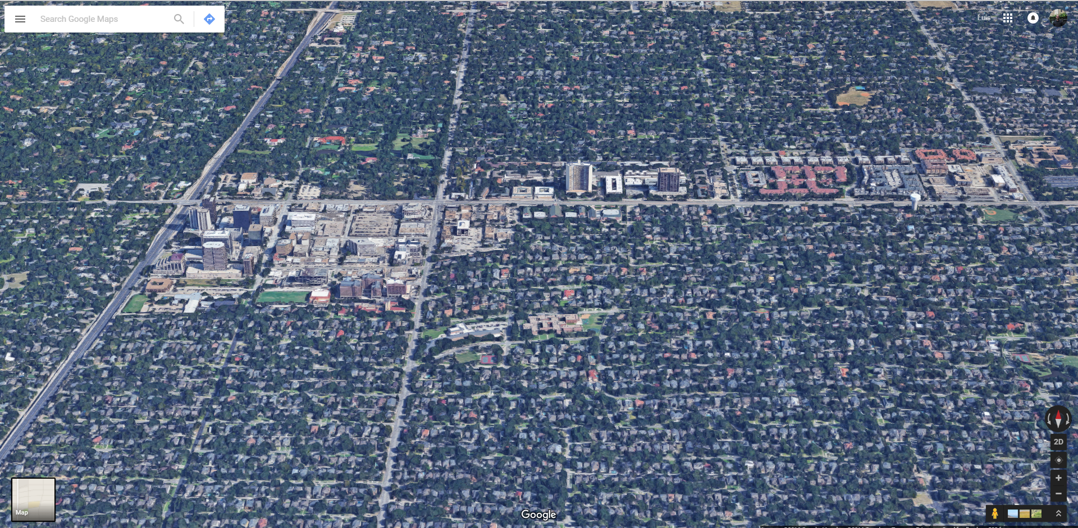
Background: Plan Area

Slide 7
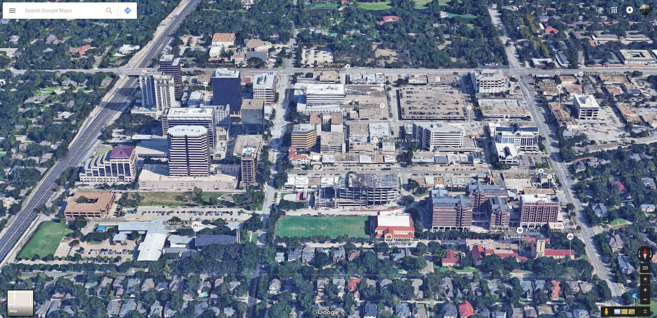
Background: Plan Area

Slide 8
Consultant Role
Technical Expertise
  Existing Conditions Analysis
    Zoning
    Development Patterns
    Infrastructure
  Parking Study
  Traffic Study
  Development Scenarios
Community Input
  Interviews
  Surveys
  Open House

Slide 9
Advisory Task Force Role
  Provide Direction, Guidance and Feedback in Establishing the Vision
  Communicated With Zone Residents and Encourage Participation
  Obtain Feedback on Specific Issues
  Review Area Plan Progress
  Draft the Area Plan before you

Slide 10
Facilitated Discussion
Neighborhood Character
Physical Environment
Streetscapes
Parks and Open Space
Public Infrastructure
Education, Culture and Community
Transportation
Economy
Sustainability
Health and Safety

