Slide 1
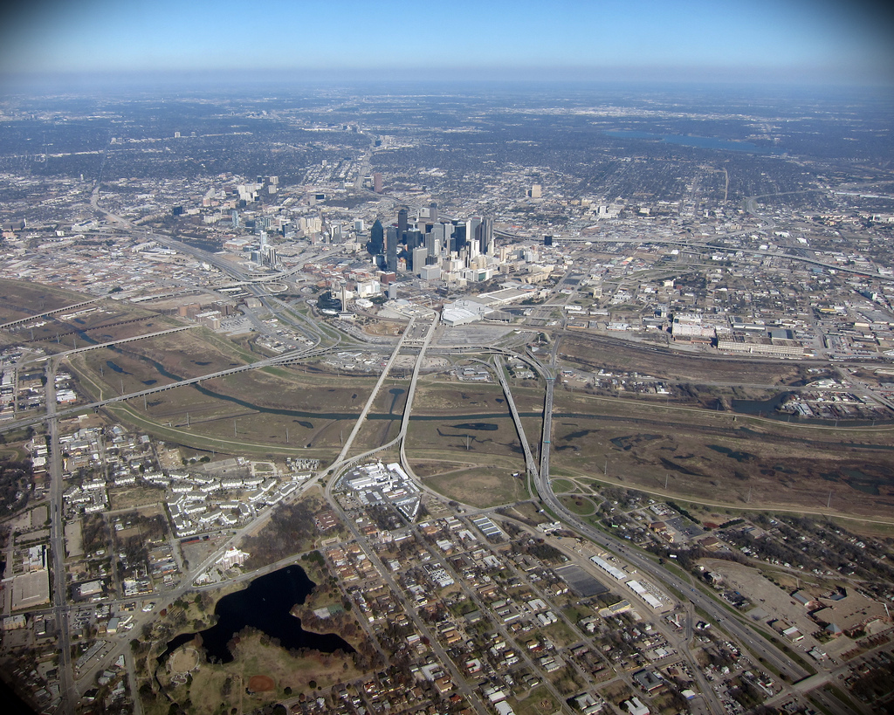
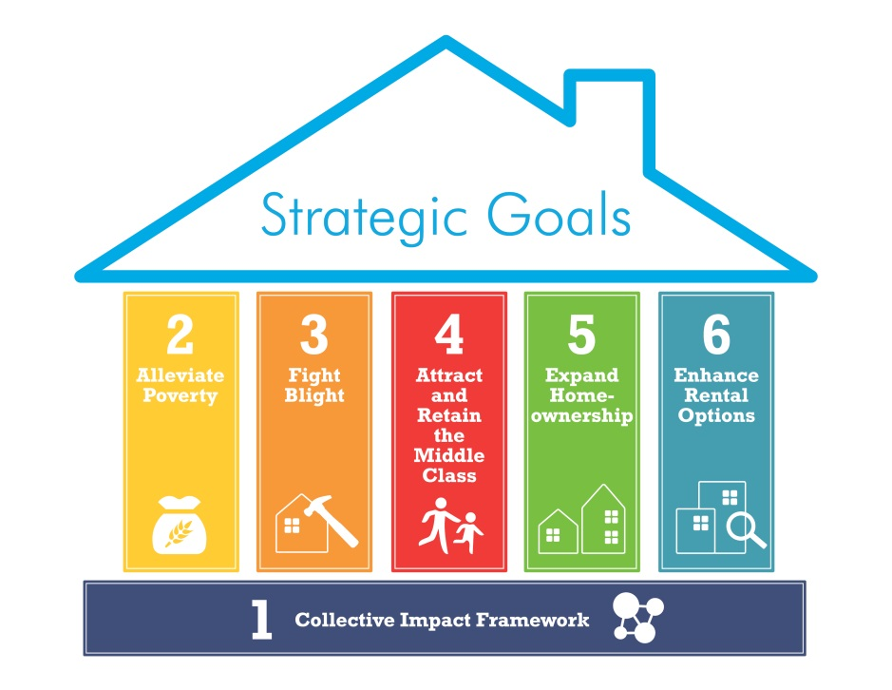

Kiest Cliff
Neighborhood Data
District 3
Councilmember Thomas
Team lead Karen Riley
January 2017

Slide 3

Target Area Highlights
  The Kimball Target Area is a predominantly single family neighborhood, high home ownership rate
  The community is diverse both racially and socio-economically
  Generally higher household incomes than the City of Dallas as a whole
  Homes are generally in good condition
    (better than city as a whole)
  Lower household incomes and multifamily dwellings are concentrated in the southwestern corner near Ledbetter and Cockrell Hill
  There area four (4) schools in the Kimball Area
  There is access to open space through parks and trails
3

Slide 4
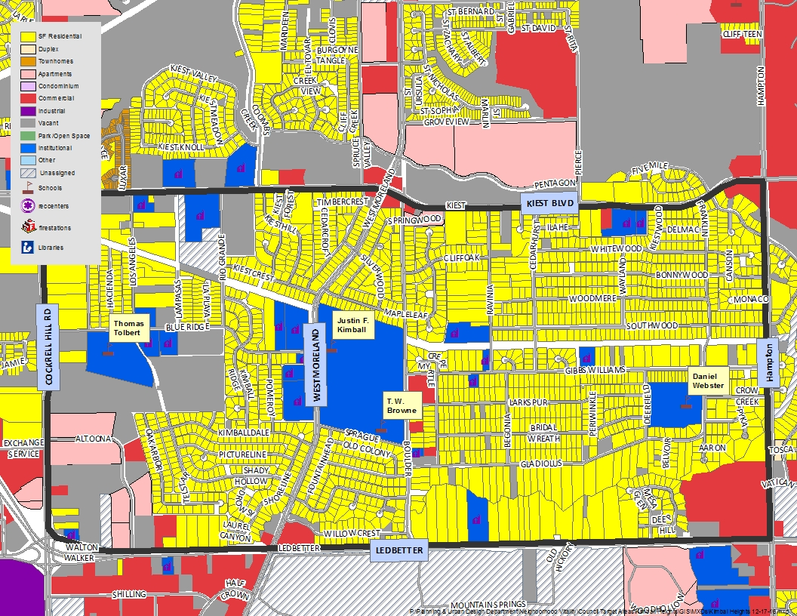
Target Area Land Use Map

Slide 5
Target Area Demographics
Total Population: 5,853
Age
  Generally older than city as a whole
Race/Ethnicity
  Diverse population breakdown
Education
  84% HS Grad Rate
  28% Bachelors or Higher
* Source: 2010-2014 5 year ACS Estimates

Slide 6
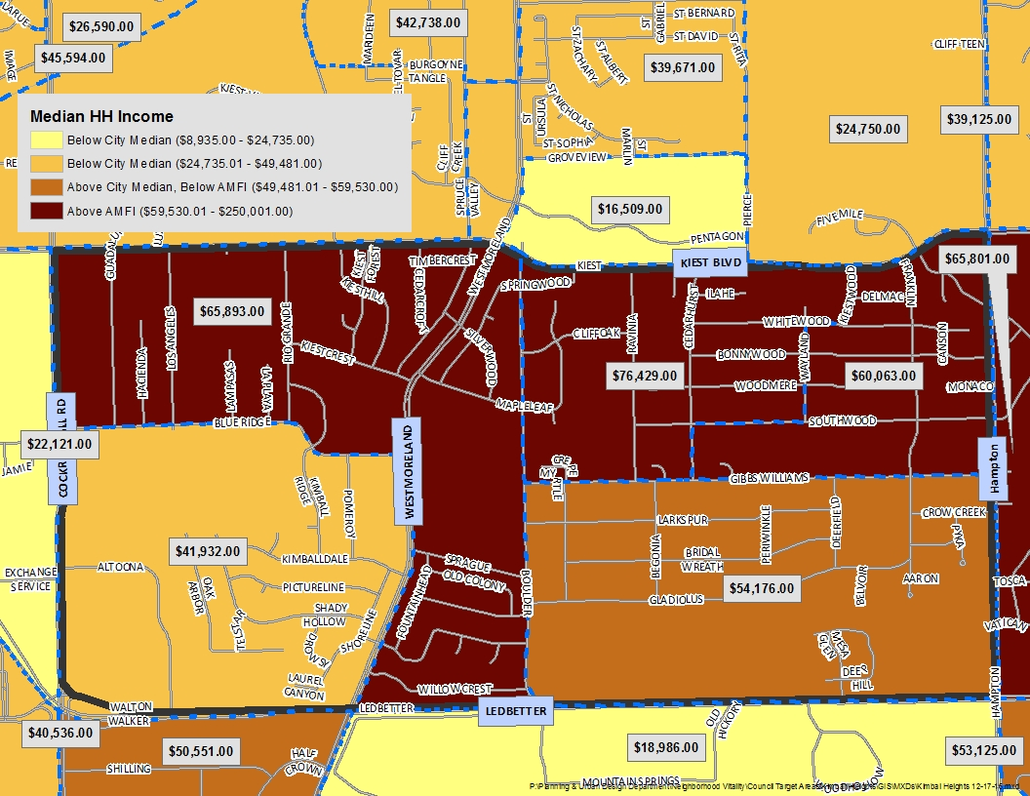
Target Area Household Incomes
2010-2014 Median Household Income
Wide range of incomes, generally higher than city as a whole
Households with Lower median incomes tend to be located in the southern portions of target area
Area poverty rate is lower (15%) in the Target Area compared to the citywide rate (24%)
* Source: 2010-2014 5 year ACS Estimates
6

Slide 7
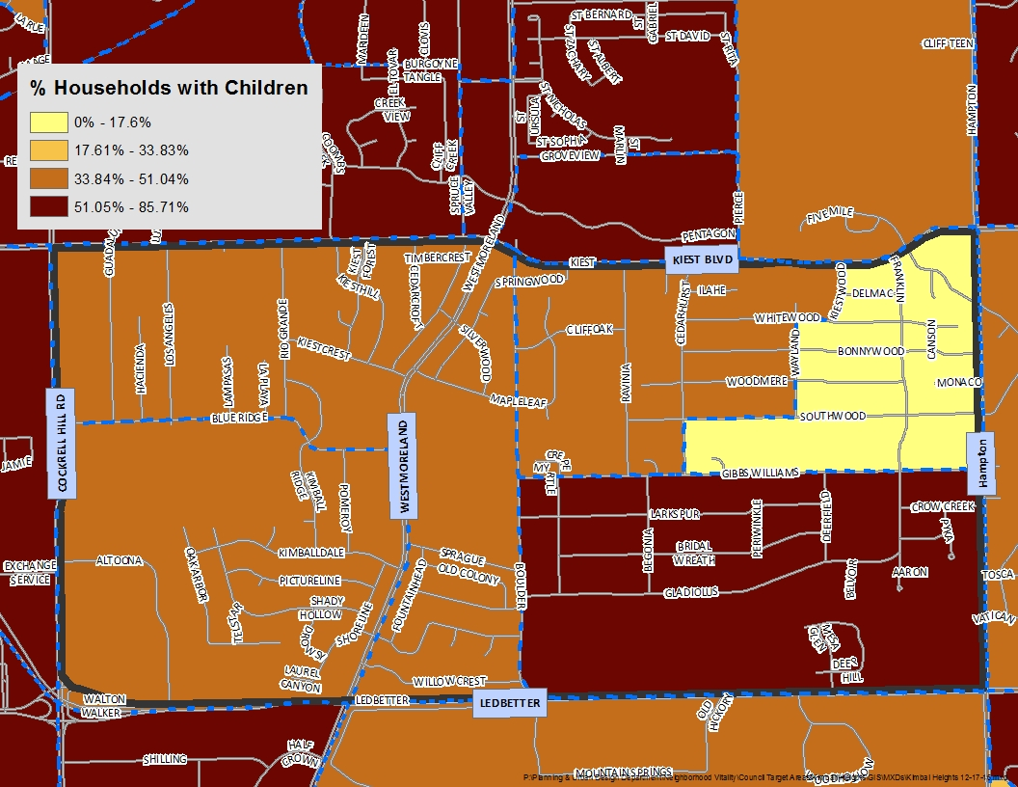
Target Area Households with Children: 2010-2014
7
* Source: 2010-2014 5-Year ACS Estimates

Slide 8
Target Area Housing Overview
Housing Type
  The housing stock in the Kimball Area is predominantly single family, and some multifamily in the southwest corner
Housing Tenure/Occupancy
  80% homeownership
  10% renter, rental single family homes scattered throughout target area
  Only 15% of the housing stock in the neighborhood is vacant
Housing Conditions
  64% of the housing stock is in above average condition, better than city average (45%)
New Construction/Improvement Activity
  No new single-family homes built within the boundaries between 2012-2014, however there were new constructed in close proximity to the Target Area.
  Scattered home improvement activity throughout neighborhood
8
* Source: 2010-2014 5 year ACS Estimates and DCAD

Slide 9
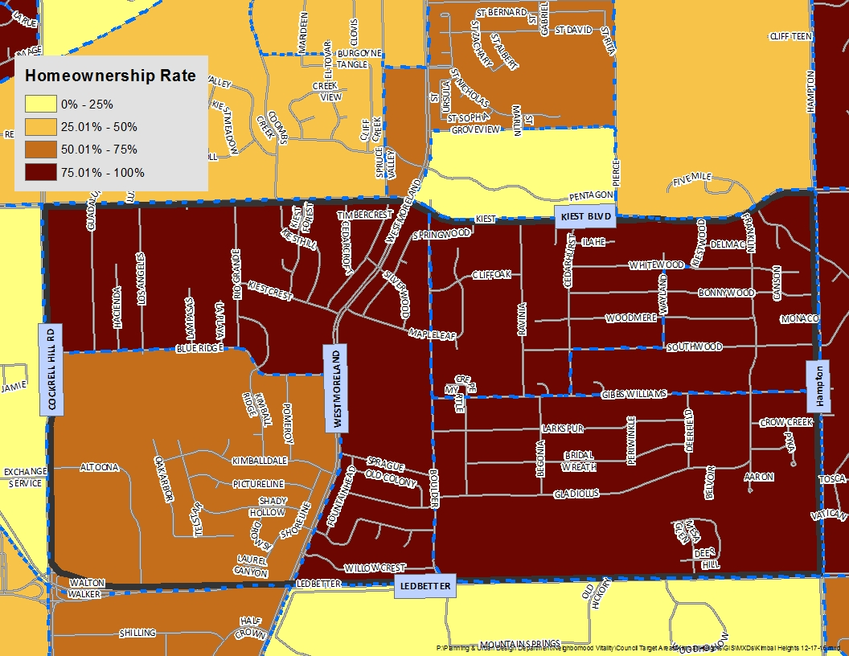
Target Area Homeownership & Rental Rates
2010-2014 Percentage of Senior Led Housing
Housing Tenure Breakdown
Renter | 435 | 21%
Owner | 1639 | 79%
* Source: 2010-2014 5-Year ACS Estimates
9

Slide 10
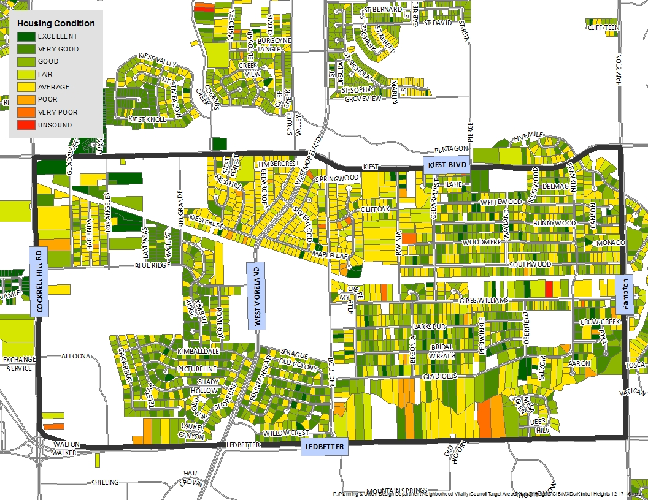
Target Area Single- Family Housing Conditions: 2015
Category | Count | Percent
Excellent | 65 | 3.6%
Very Good | 356 | 19.8%
Good | 538 | 29.9%
Fair | 190 | 10.5%
Average | 616 | 34.2%
Poor | 26 | 1.4%
Very Poor | 9 | 0.5%
Unsound | 1 | 0.1%
Total | 1801
Above Average | 1149 | 63.8%
Citywide Rate: 45% of Housing Units Above City Average
* Source: DCAD 2015
10

Slide 11
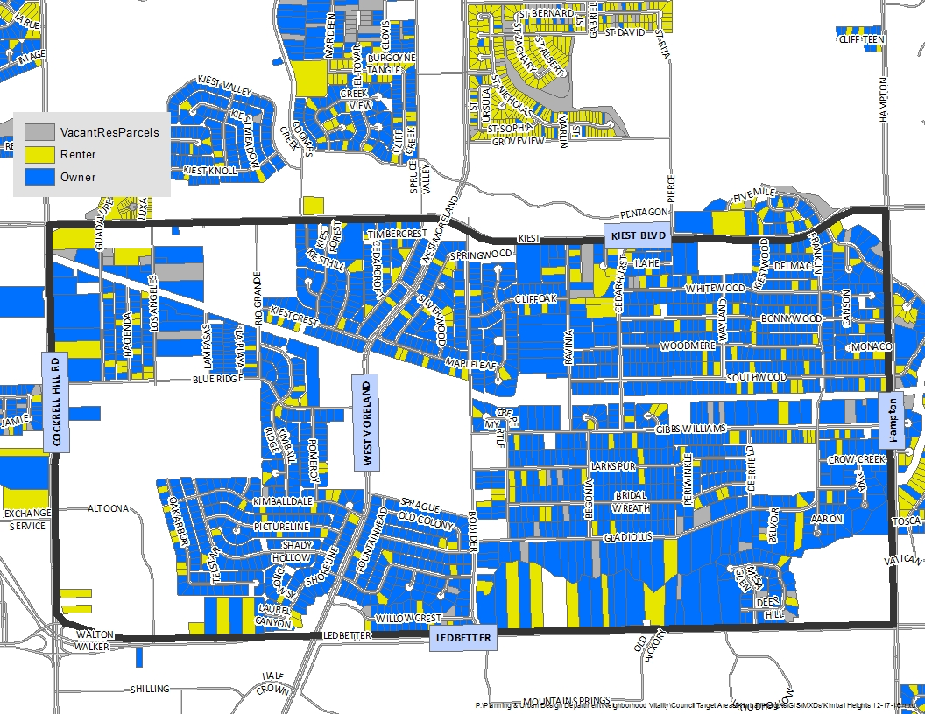
Target Area Single Family Home Ownership/Rental: 2010-2014
Category | Count | Percent
Owner | 1611 | 89.4%
Renter | 191 | 10.6%
Total | 1802
11
* Source: 2010-2014 5-Year ACS Estimates

Slide 12
Category |  | Notes
In CDBG Eligible Area? | Yes | Partial
In a DPD TAAG Area? | Yes | Small parts of the north and south
DART Station Within ½ Mile? | No | Westmoreland 1 mile north
Community Prosecution Area? | No
Parks Within ¼ Mile? | Yes | Kiestwood Trail, Doris Berry
TIF/PID? | No
Library? | No
Dallas ISD? | Yes | Thomas Tolbert Elementary, Daniel Webster Elementary, T.W. Browne Middle School, Justin F. Kimball High School
Charter School? | No
Recreation Center? | No
Other Assets
12

Slide 13
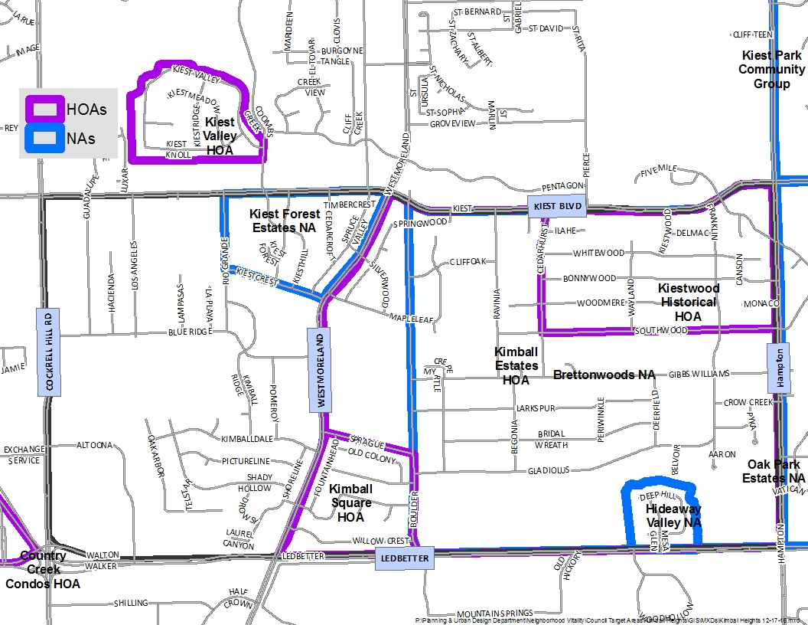
Target Area Homeowner and Neighborhood Association Groups
Neighborhood Associations
  Kiest Forest Estates NA
  Brettonwoods NA
  Hideaway Valley NA
Homeowner Associations
  Kimball Estates HOA
  Kimball Square HOA
  Kiestwood Historical HOA
13
* Source: City of Dallas Planning & Urban Design Department

Slide 14
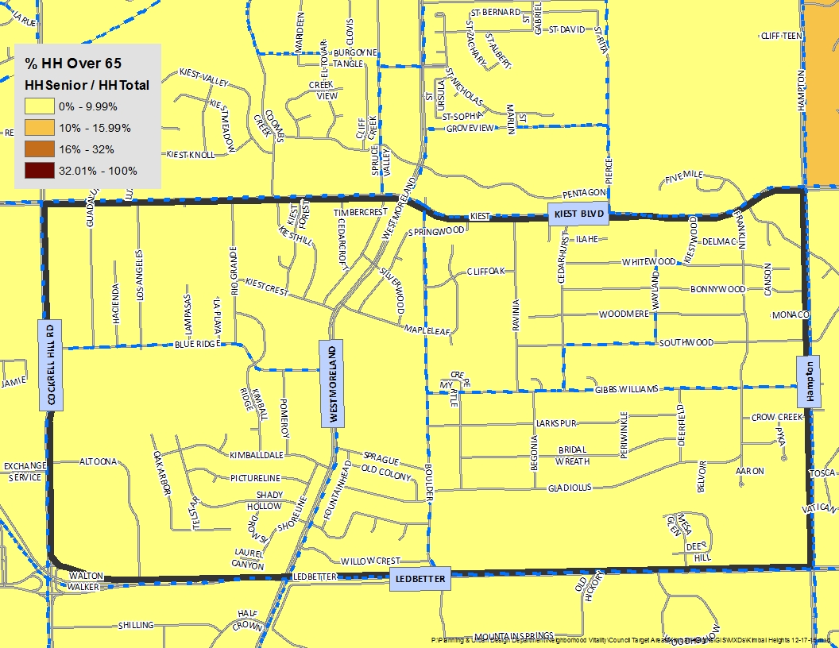
Target Area Senior Led Households
* Source: 2010-2014 5-Year ACS Estimates

Slide 15
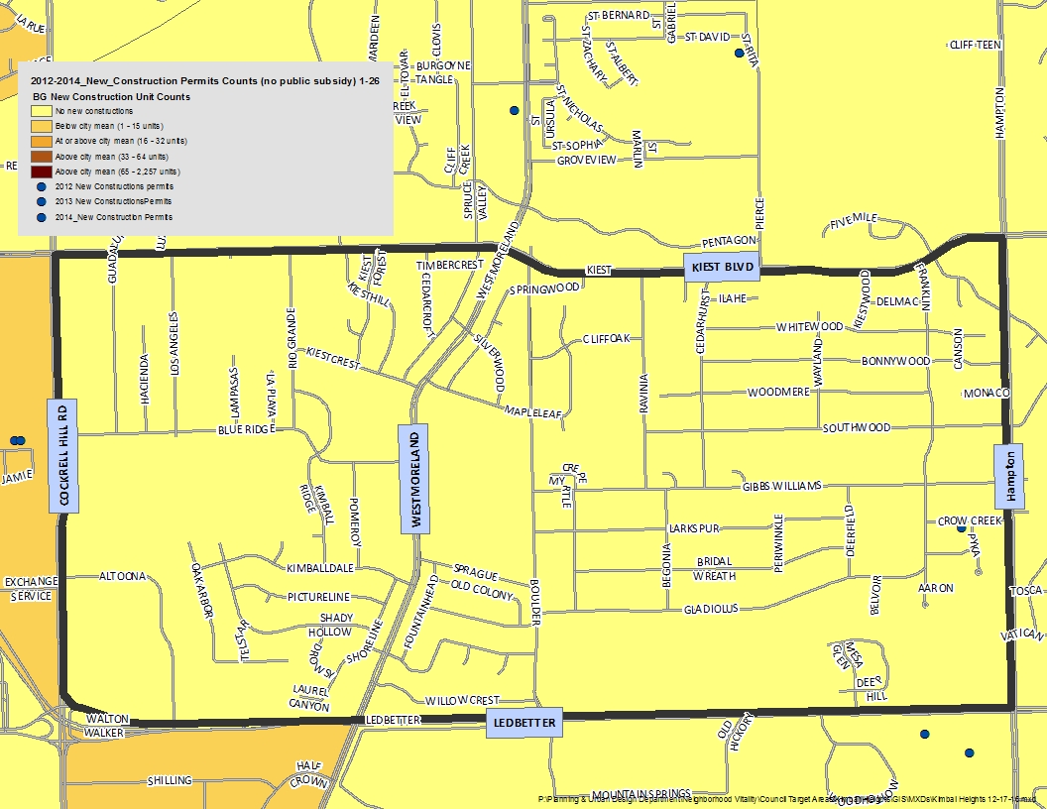
New Single- Family Home Construction 2012-2014
15
* Source: City of Dallas 2012- 2014 Permit data

Slide 16
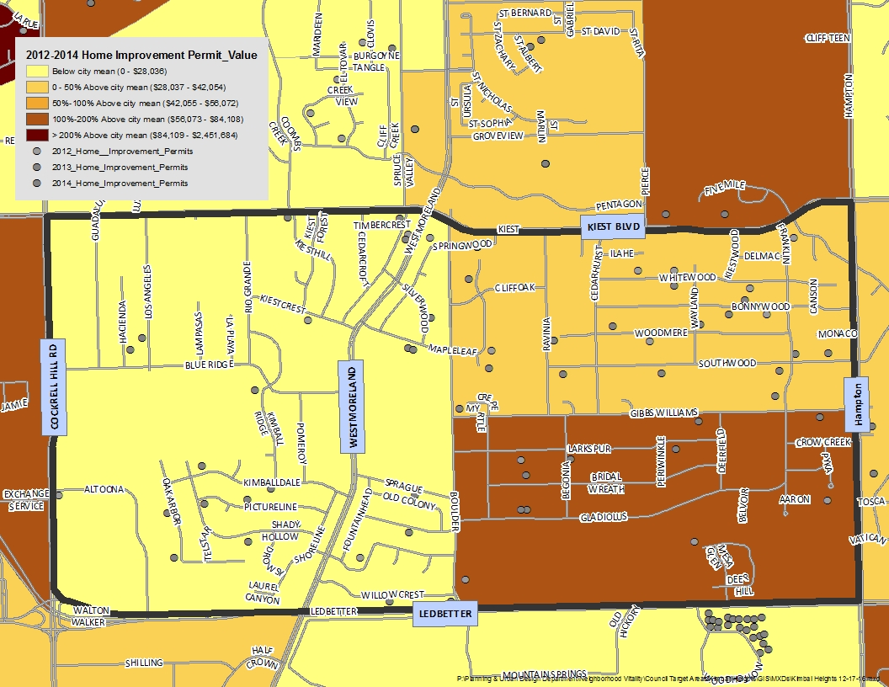
Target Area Home Improvement Permits: 2012-2014
* Source: City of Dallas 2012- 2014 Permit data
16

Slide 17
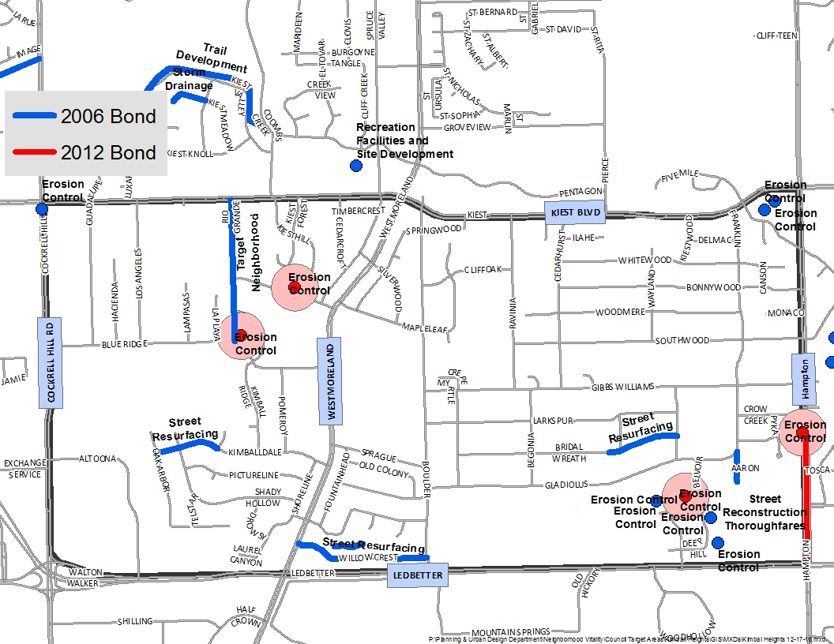
Target Area Bond Projects
17
* Source: City of Dallas –Public Works

Slide 18
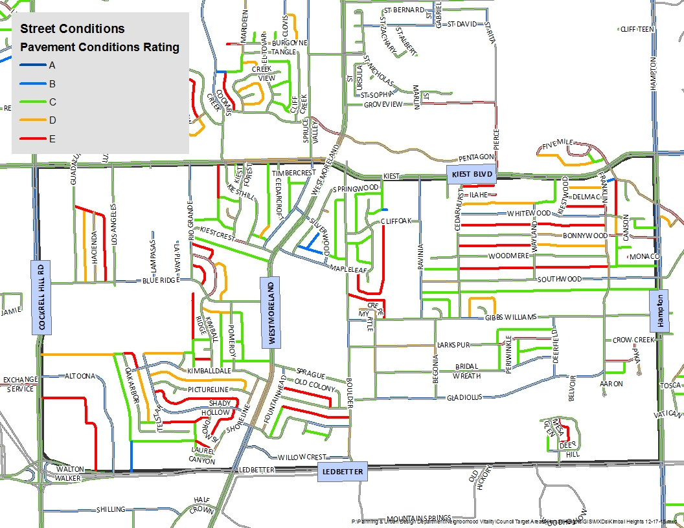
Target Area Street Conditions
2015 Street Conditions
* Source: City of Dallas Public Works

