Slide 1
Classification Action Form (CAF) Accepted from October 1st - April 1st.
How to Initiate in Workday.

Slide 2
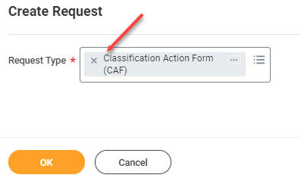
As Manager
Type “Create Request” (in Workday search box).
Under Request Type – Select “Classification Action Form (CAF)”.
Click OK.
Fill all required fields.
Once completed Click “Submit”.
Once the Request is submitted, the transaction will route for corresponding approvals.

Slide 3
Department Director
A notification will be sent out upon CAF form submission.
Click on “Inbox” in Workday.
Click on “Request Process” Classification Action Form (CAF).
Review the Form.
Enter any comments in comment box (if applicable) and “Approve”, “Deny”, or “Send Back”.

Slide 4
Budget Office Partner
A notification will be sent out after approval from Department Director.
Click on “Inbox” in Workday.
Click on “Request Process” Classification Action Form (CAF).
Review the Form.
Enter any comments in comment box (if applicable) and “Approve”, “Deny”, or “Send Back”.

Slide 5
Budget Office Administrator
A notification will be sent out after approval from Budget Office Partner.
Click on “Inbox” in Workday.
Click on “Request Process” Classification Action Form (CAF).
Review the Form.
Enter any comments in comment box (if applicable) and “Approve”, “Deny”, or “Send Back”.

Slide 6
Assistant City Manager
A notification will be sent out after approval from Budget Office Administrator.
Click on “Inbox” in Workday.
Click on “Request Process” Classification Action Form (CAF).
Review the Form.
Enter any comments in comment box (if applicable) and “Approve”, “Deny”, or “Send Back”.

Slide 7
Compensation Partner
A notification will be sent out after approval from Assistant City Manager.
Click on “Inbox” in Workday.
Click on “Request Process” Classification Action Form (CAF).
Review the Form.
Enter any comments in comment box (if applicable) and “Approve”, “Deny”, or “Send Back”.

Slide 8
Compensation Administrator
A notification will be sent out after approval from Compensation Partner.
Click on “Inbox” in Workday.
Click on “Request Process” Classification Action Form (CAF).
Review the Form.
Enter any comments in comment box (if applicable) and “Approve”, “Deny”, or “Send Back”.

Slide 9
Compensation Partner Instructions
A notification will be sent out after approval from Compensation Administrator.
This step is To Do you can click on “Edit Job Restrictions” and Edit or Click to “Submit” for next step.
Click on “Inbox” in Workday.
Click on “Request Process” Classification Action Form (CAF).
Edit Job Restrictions.
Click Submit.

Slide 10
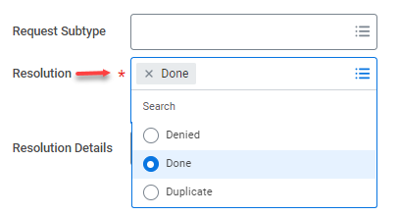
As Manger (or Original Initiator)
A notification will be sent out after approval from Compensation Partner.
Click on “Inbox” in Workday
Click on “Request Process” Classification Action Form (CAF).
Review the Form.
Select “Denied”, or “Done”, or “Duplicate” from “Resolution” drop down.
Click Submit to close the Request.

